Slide 1
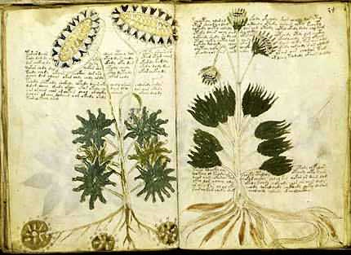
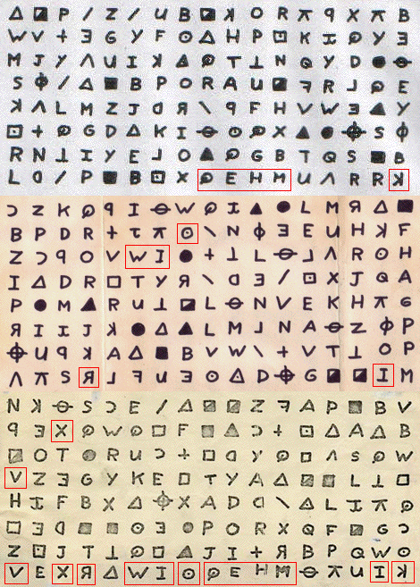
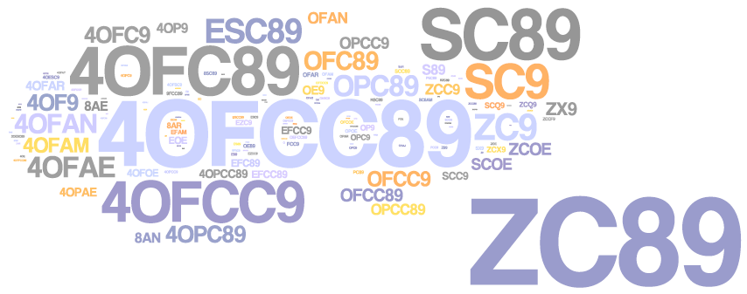
Decipherment
Kevin Knight
Information Sciences Institute
University of Southern California
includes joint work with:
S. Ravi (USC/ISI, now Google), Q. Dou, K. Yamada (USC/ISI)
B. Megyesi, C. Schaefer (Uppsala Univ.)
R. Barzilay, B. Snyder (MIT)
S. Reddy (Univ. Chicago, now Dartmouth)
ACL Tutorial August 2013
kfnKlknacbfJmk
lbuvcKhtrhbkKDkn
fKKnkbKbecb ...

Slide 2
Why Decipherment?
It’s fun and cool
ancient languages
secret societies
Breaking codes was the first application of NLP
Intellectual root of NLP
language models, log-odds ratios, smoothing
ASR and MT use "decoders"
View foreign language as a code for English

Slide 3
Decipherment Papers by ACL-ers
"Unsupervised Analysis for Decipherment Problems,“ (K. Knight, A. Nair, N. Rathod, and K. Yamada), Proc. ACL-COLING, 2006. (Rejected four times previously, but OK!)
"Attacking Decipherment Problems Optimally with Low-Order N-gram Models," (S. Ravi and K. Knight), Cryptologia, 2009.
"Probabilistic Methods for a Japanese Syllable Cipher," (S. Ravi and K. Knight), Proc. ICCPOL, 2009.
"A Statistical Model for Lost Language Decipherment," (B. Snyder, R. Barzilay, and K. Knight), Proc. ACL, 2010.
"An Exact A* Method for Deciphering Letter-Substitution Ciphers," (E. Corlett and G. Penn), Proc. ACL, 2010.
"Deciphering Foreign Language," (S. Ravi and K. Knight), Proc. ACL, 2011.
"The Copiale Cipher," (K. Knight, B. Megyesi, and C. Schaefer), Proc. ACL BUCC, 2011.
"Bayesian Inference for Zodiac and Other Homophonic Ciphers," (S. Ravi and K. Knight), Proc. ACL, 2011.
"What We Know About the Voynich Manuscript," (S. Reddy and K. Knight), Proc. ACL LaTECH, 2011.
"Simple Effective Decipherment via Combinatorial Optimization," (T. Berg-Kirkpatrick and D. Klein), Proc. EMNLP, 2011.
"Decoding Running Key Ciphers," (S. Reddy and K. Knight), Proc. ACL, 2012.
"Large Scale Decipherment for Out-of-Domain Machine Translation," (Q. Dou and K. Knight), Proc. EMNLP, 2012.
"Deciphering Foreign Language by Combining Language Models and Context Vectors," (M. Nuhn, A. Mauser, and H. Ney), Proc. ACL, 2012.
"Decipherment Complexity in 1:1 Substitution Ciphers," (M. Nuhn, and H. Ney), Proc. ACL, 2013.
"Beam Search for Solving Substitution Ciphers," (M. Nuhn, J. Schamper, and H. Ney), Proc. ACL, 2013.
"Scalable decipherment for machine translation via hash sampling," (S. Ravi), Proc. ACL, 2013.
“Unsupervised Consonant-Vowel Prediction over Hundreds of Languages,” (Y. Kim and B. Snyder), Proc. ACL, 2013.

Slide 4
Outline
Classical military/diplomatic ciphers (15 mins)
Foreign language as a code (10 mins)
Automatic decipherment (55 mins)
Break (30 mins)
Unsolved ciphers (40 mins)
Writing as a code for speech (20 mins)
Undeciphered writing systems (15 mins)
Conclusions (15 mins)

Slide 5
Classical military/diplomatic ciphers

Slide 6
Letter Substitution Cipher
Encipherment key:
PLAIN: ABCDEFGHIJKLMNOPQRSTUVWXYZ
CIPHER: PLOKMIJNUHBYGVTFCRDXESZAQW
Plaintext: HELLO KITTY ...
Ciphertext: NMYYT BUXXQ ...
Key itself doesn’t change: "simple substitution"
What key, if applied to the ciphertext, would yield sensible plaintext?

Slide 7
KDCY LQZKTLJKX CY MDBCYJQL: "TR
HYD FKXC, FQ MKX RLQQIQ HYDL
MKL DXCTW RDCDLQ JQMNKXTMB
PTBMYEQL K FKH CY LQZKTL TC."

Slide 8
KDCY LQZKTLJKX CY MDBCYJQL: "TR
HYD FKXC, FQ MKX RLQQIQ HYDL
MKL DXCTW RDCDLQ JQMNKXTMB
PTBMYEQL K FKH CY LQZKTL TC."
A
B 3
C 8
D 7
E 1
F 3
G
H 3
I 1
J 3
K 10
L 10
M 6
N 1
O
P 1
Q 10
R 3
S
T 7
U
V
W 1
X 5
Y 7
Z 2

Slide 9
. . . .
KDCY LQZKTLJKX CY MDBCYJQL: "TR
. . . . . .
HYD FKXC, FQ MKX RLQQIQ HYDL
. . . .
MKL DXCTW RDCDLQ JQMNKXTMB
. . . . .
PTBMYEQL K FKH CY LQZKTL TC."
A
B 3
C 8
D 7
E 1 .
F 3 .
G
H 3 .
I 1 .
J 3 .
K 10
L 10
M 6
N 1 .
O
P 1 .
Q 10
R 3 .
S
T 7
U
V
W 1 .
X 5
Y 7
Z 2 .

Slide 10
. . . .
KDCY LQZKTLJKX CY MDBCYJQL: "TR
. . . . . .
HYD FKXC, FQ MKX RLQQIQ HYDL
. . . .
MKL DXCTW RDCDLQ JQMNKXTMB
. . . . .
PTBMYEQL K FKH CY LQZKTL TC."
A
B 3
C 8
D 7 #
E 1 .
F 3 .
G
H 3 .
I 1 .
J 3 .
K 10 ##### V
L 10 ##
M 6 #
N 1 .
O
P 1 .
Q 10 ######### V
R 3 .
S
T 7 ### V
U
V
W 1 .
X 5
Y 7 #### V
Z 2 .

Slide 11
a .a .a . .
KDCY LQZKTLJKX CY MDBCYJQL: "TR
. .a . a . . .
HYD FKXC, FQ MKX RLQQIQ HYDL
a . . . .a
MKL DXCTW RDCDLQ JQMNKXTMB
. . a .a. .a
PTBMYEQL K FKH CY LQZKTL TC."
A
B 3
C 8
D 7 #
E 1 .
F 3 .
G
H 3 .
I 1 .
J 3 .
K 10 ##### V
L 10 ##
M 6 #
N 1 .
O
P 1 .
Q 10 ######### V
R 3 .
S
T 7 ### V
U
V
W 1 .
X 5
Y 7 #### V
Z 2 .

Slide 12
a e.a .a .e .
KDCY LQZKTLJKX CY MDBCYJQL: "TR
. .a .e a . ee.e .
HYD FKXC, FQ MKX RLQQIQ HYDL
a . . e .e .a
MKL DXCTW RDCDLQ JQMNKXTMB
. .e a .a. e.a
PTBMYEQL K FKH CY LQZKTL TC."
A
B 3
C 8
D 7 #
E 1 .
F 3 .
G
H 3 .
I 1 .
J 3 .
K 10 ##### V
L 10 ##
M 6 #
N 1 .
O
P 1 .
Q 10 ######### V
R 3 .
S
T 7 ### V
U
V
W 1 .
X 5
Y 7 #### V
Z 2 .
didn’t create "ae"

Slide 13
a e.ao .a .e o.
KDCY LQZKTLJKX CY MDBCYJQL: "TR
. .a .e a . ee.e .
HYD FKXC, FQ MKX RLQQIQ HYDL
a o. . e .e .a o
MKL DXCTW RDCDLQ JQMNKXTMB
.o .e a .a. e.ao o
PTBMYEQL K FKH CY LQZKTL TC."
A
B 3
C 8
D 7 #
E 1 .
F 3 .
G
H 3 .
I 1 .
J 3 .
K 10 ##### V
L 10 ##
M 6 #
N 1 .
O
P 1 .
Q 10 ######### V
R 3 .
S
T 7 ### V
U
V
W 1 .
X 5
Y 7 #### V
Z 2 .
don’t like "ao" – back up!

Slide 14
a o e.a .a o o.e .
KDCY LQZKTLJKX CY MDBCYJQL: "TR
.o .a .e a . ee.e .o
HYD FKXC, FQ MKX RLQQIQ HYDL
a . . e .e .a
MKL DXCTW RDCDLQ JQMNKXTMB
. o.e a .a. o e.a
PTBMYEQL K FKH CY LQZKTL TC."
A
B 3
C 8
D 7 #
E 1 .
F 3 .
G
H 3 .
I 1 .
J 3 .
K 10 ##### V
L 10 ##
M 6 #
N 1 .
O
P 1 .
Q 10 ######### V
R 3 .
S
T 7 ### V
U
V
W 1 .
X 5
Y 6 #### V
Z 2 .

Slide 15
a o re.a r.a o o.e f
KDCY LQZKTLJKX CY MDBCYJQL: "TR
.o .a .e a freeze .o r
HYD FKXC, FQ MKX RLQQIQ HYDL
ar . f re .e .a
MKL DXCTW RDCDLQ JQMNKXTMB
. o.er a .a. o re.a r
PTBMYEQL K FKH CY LQZKTL TC."
A
B 3
C 8
D 7 #
E 1 .
F 3 .
G
H 3 .
I 1 .
J 3 .
K 10 ##### V
L 10 ##
M 6 #
N 1 .
O
P 1 .
Q 10 ######### V
R 3 .
S
T 7 ### V
U
V
W 1 .
X 5
Y 6 #### V
Z 2 .

Slide 16
a o re.a r.a o o.e f
KDCY LQZKTLJKX CY MDBCYJQL: "TR
.o .a .e a freeze .o r
HYD FKXC, FQ MKX RLQQIQ HYDL
ar . f re .e .a
MKL DXCTW RDCDLQ JQMNKXTMB
. o.er a .a. o re.a r
PTBMYEQL K FKH CY LQZKTL TC."
A
B 3
C 8
D 7 #
E 1 .
F 3 .
G
H 3 .
I 1 .
J 3 .
K 10 ##### V
L 10 ##
M 6 #
N 1 .
O
P 1 .
Q 10 ######### V
R 3 .
S
T 7 ### V
U
V
W 1 .
X 5
Y 6 #### V
Z 2 .
frequent cipher letters: Q L K C D T M Y X
frequent English letters: e t o a n i r s h

Slide 17
a no re.air.a no no.e if
KDCY LQZKTLJKX CY MDBCYJQL: "TR
.o .a n .e a freeze .o r
HYD FKXC, FQ MKX RLQQIQ HYDL
ar ni. f n re .e .a i
MKL DXCTW RDCDLQ JQMNKXTMB
.i o.er a .a. no re.air in
PTBMYEQL K FKH CY LQZKTL TC."
A
B 3
C 8
D 7 #
E 1 .
F 3 .
G
H 3 .
I 1 .
J 3 .
K 10 ##### V
L 10 ##
M 6 #
N 1 .
O
P 1 .
Q 10 ######### V
R 3 .
S
T 7 ### V
U
V
W 1 .
X 5
Y 6 #### V
Z 2 .
frequent cipher letters: Q L K C D T M Y X
frequent English letters: e t o a n i r s h

Slide 18
a to re.air.a to to.e if
KDCY LQZKTLJKX CY MDBCYJQL: "TR
.o .a t .e a freeze .o r
HYD FKXC, FQ MKX RLQQIQ HYDL
ar ti. f t re .e .a i
MKL DXCTW RDCDLQ JQMNKXTMB
.i o.er a .a. to re.air it
PTBMYEQL K FKH CY LQZKTL TC."
A
B 3
C 8
D 7 #
E 1 .
F 3 .
G
H 3 .
I 1 .
J 3 .
K 10 ##### V
L 10 ##
M 6 #
N 1 .
O
P 1 .
Q 10 ######### V
R 3 .
S
T 7 ### V
U
V
W 1 .
X 5
Y 6 #### V
Z 2 .
frequent cipher letters: Q L K C D T M Y X
frequent English letters: e t o a n i r s h

Slide 19
a to repair.a to to.e if
KDCY LQZKTLJKX CY MDBCYJQL: "TR
.o .a t .e a freeze .o r
HYD FKXC, FQ MKX RLQQIQ HYDL
ar ti. f t re .e .a i
MKL DXCTW RDCDLQ JQMNKXTMB
.i o.er a .a. to repair it
PTBMYEQL K FKH CY LQZKTL TC."
A
B 3
C 8
D 7 #
E 1 .
F 3 .
G
H 3 .
I 1 .
J 3 .
K 10 ##### V
L 10 ##
M 6 #
N 1 .
O
P 1 .
Q 10 ######### V
R 3 .
S
T 7 ### V
U
V
W 1 .
X 5
Y 6 #### V
Z 2 .
frequent cipher letters: Q L K C D T M Y X
frequent English letters: e t o a n i r s h

Slide 20
auto repairman to customer: if
KDCY LQZKTLJKX CY MDBCYJQL: "TR
you want we can freeze your
HYD FKXC, FQ MKX RLQQIQ HYDL
car until future mechanics
MKL DXCTW RDCDLQ JQMNKXTMB
discover a way to repair it
PTBMYEQL K FKH CY LQZKTL TC."
A
B 3
C 8
D 7 #
E 1 .
F 3 .
G
H 3 .
I 1 .
J 3 .
K 10 ##### V
L 10 ##
M 6 #
N 1 .
O
P 1 .
Q 10 ######### V
R 3 .
S
T 7 ### V
U
V
W 1 .
X 5
Y 6 #### V
Z 2 .

Slide 21
Pattern word dictionaries
KDCY LQZKTLJKX CY MDBCYJQL: "TR
HYD FKXC, FQ MKX RLQQIQ HYDL
MKL DXCTW RDCDLQ JQMNKXTMB
PTBMYEQL K FKH CY LQZKTL TC."
abcdeafdg
abnegated
abnegates
advocator
airedales
alienages
alienated
alienates
amperages
cadencies
capricorn
cogencies
escapeway
healthily
imbeciles
imperiled
incurious
inherited
injurious
landslide
octagonal
oklahoman
overboard
repairman
sacristry
unrebuked
unsecured
abccdc
abcdefghijklm
basses
bassos
bosses
breeze
budded
...
cheese
cusses
dosses
finnan
fleece
fosses
freeze
...
terror
tosses
tweeze
wadded
wheeze
consumptively
copyrightable
documentarily
lycanthropies
musicotherapy
semivoluntary
subordinately
unpredictably
OR, NORWEGIAN!
filmprodusent
kurspamelding
publikasjoner
stylemarginpx
uproblematisk

Slide 22
Fundamental Questions
How much English does a system need to know to break a cipher?
How long does the cipher need to be, to admit a unique solution?
How much computational effort is required to decipher?
and…

Slide 23
How to Make Things Harder?
Homophonic cipher
ciphertext values from 00 to 99
A → 02, 14, 16, 22, 49, 51, 58, 90
B → 04, 76
C → 15, 56, 71
etc
flattens out ciphertext distribution
“a cab…” becomes “22 56 14 04…”
still deterministic in the deciphering direction
Polyalphabetic ciphers
the secret key changes at each plaintext letter token
e.g., rotate through 10 different keys
Transposition ciphers
or perhaps:
A = 5 j l ( R
B = U
C = & D
D = ]
E = X f < " _ I Z 3
F = Q
G = y ...

Slide 24
Cipher Types
http://cryptogram.org/cipher_types.html
documents ~70 types
E.g., RUNNING KEY cipher
key = agreed-upon standard English text
ciphertext(i) = [ plaintext(i) + key(i) ] mod 26
effectively uses 26 substitution keys
breakable!
we search for a key and (resulting) plaintext that are both natural language

Slide 25
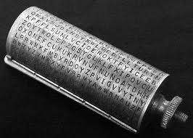
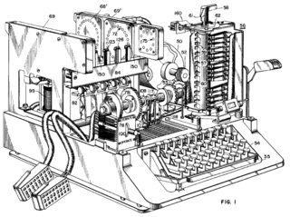
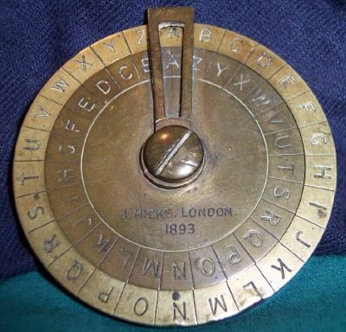
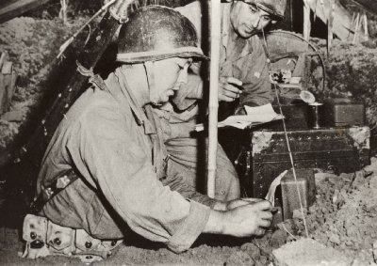
How to Make Things Efficient?
Mechanical encryption/decryption devices

Slide 26
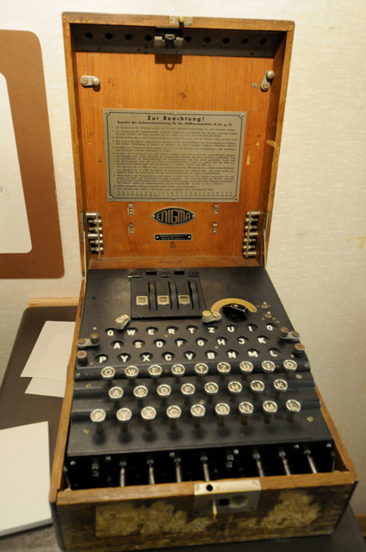
“First NLP Task Ever” (1930s-40s) Breaking the German Enigma Cipher
over the
radio:
DFKWIFKS
LWORISJD
KSUEIFKR …
German
text →
German
→ text
→
→
input (intercepted ciphertext): DFKWIFKSLWORISJDKSUEIFKR …
output (plaintext): VASISTDASHERRCAPITANRICH …

Slide 27
“First NLP Task Ever” (1930s-40s) Breaking the German Enigma Cipher
Secret key =
initial rotor
ordering and
settings
Substitution system
N → J
Reversible behavior
NNN → JTE → NNN
Substitution table changes
with every keystroke:
NNN → JTE
Flattens out ciphertext
letter distributions.

Slide 28
Breaking Enigma
cipher
text
substitution
proposed
plaintext
German
Is it German?
guessed
key

Slide 29
Breaking Enigma
cipher
text
substitution
proposed
plaintext
German
Is it German?
guessed
key
SHANNON TURING KULLBACK

Slide 30
Breaking Enigma
cipher
text
substitution
proposed
plaintext
German
Is it German?
guessed
key
POLISH CIPHER BUREAU &
BLETCHLEY PARK
LOOK FOR ENIGMA
SETTINGS THAT YIELD PLAINTEXT PATTERN
"XYZXYZ…"
BOMBE

Slide 31
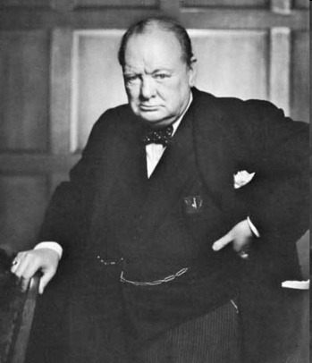
Breaking Enigma
cipher
text
substitution
proposed
plaintext
German
Is it German?
guessed
key
?
?
?
?
POLISH CIPHER BUREAU &
BLETCHLEY PARK
LOOK FOR ENIGMA
SETTINGS THAT YIELD PLAINTEXT PATTERN
"XYZXYZ…"
WINSTON
CHURCHILL
BOMBE

Slide 32
Enigma
Mathematical breakthroughs:
Log-odds for weight of evidence [Good, Turing]
Smoothing with prior [Good, Turing]
Information theory [Shannon]
1945: War ends
1973: Wartime Enigma decipherment leaked
1975: Last surplus Enigma given to developing countries
1996: One Turing Enigma treatise declassified
2012: Another declassified (but have to go to England)
elegant,
powerful,
widely-applicable
mathematics

Slide 33

Turing Enigma Treatise (aka NR 964, Box 201, RG 457, aka "The Prof’s Book")
140pp (written sometime between 1939 and 1942)
One method is to try independently all the possible positions for the middle wheel. We shall want to know the middle wheel couplings which are consequences of these various assumptions. This can be done by setting up inverse rods for the middle wheel. The rods are paired off according to R.H.W. couplings, i.e. M.W. output. This has been done for the couplings ku, fx, ep which arose in the DANZIGVON crib in Fig 55, assuming the red wheel in the middle. The pairs in each column of this set up give possible M.W. couplings. We have now to find out whether these couplings are possible. Our procedure is rather different according as the U.K.W. does or does not rotate. In the case that the U.K.W. does not rotate it will be sufficient to have a Foss sheet (the rows and columns lettered preferably with the diagonal alphabet) in which, in the RW square are entered the positions of the left hand wheel at which the RW is one of the pairs in the L.H.W. output alphabet Fig 51. This is known as the ‘short catalogue’ for this wheel.

Slide 34
Turing Enigma Treatise (aka NR 964, Box 201, RG 457, aka "The Prof’s Book")
140pp (written sometime between 1939 and 1942)
One method is to try independently all the possible positions for the middle wheel. We shall want to know the middle wheel couplings which are consequences of these various assumptions. This can be done by setting up inverse rods for the middle wheel. The rods are paired off according to R.H.W. couplings, i.e. M.W. output. This has been done for the couplings ku, fx, ep which arose in the DANZIGVON crib in Fig 55, assuming the red wheel in the middle. The pairs in each column of this set up give possible M.W. couplings. We have now to find out whether these couplings are possible. Our procedure is rather different according as the U.K.W. does or does not rotate. In the case that the U.K.W. does not rotate it will be sufficient to have a Foss sheet (the rows and columns lettered preferably with the diagonal alphabet) in which, in the RW square are entered the positions of the left hand wheel at which the RW is one of the pairs in the L.H.W. output alphabet Fig 51. This is known as the ‘short catalogue’ for this wheel.
elegant,
powerful
widely-applicable
mathematics

Slide 35
Turing Enigma Treatise (aka NR 964, Box 201, RG 457, aka "The Prof’s Book")
140pp (written sometime between 1939 and 1942)
One method is to try independently all the possible positions for the middle wheel. We shall want to know the middle wheel couplings which are consequences of these various assumptions. This can be done by setting up inverse rods for the middle wheel. The rods are paired off according to R.H.W. couplings, i.e. M.W. output. This has been done for the couplings ku, fx, ep which arose in the DANZIGVON crib in Fig 55, assuming the red wheel in the middle. The pairs in each column of this set up give possible M.W. couplings. We have now to find out whether these couplings are possible. Our procedure is rather different according as the U.K.W. does or does not rotate. In the case that the U.K.W. does not rotate it will be sufficient to have a Foss sheet (the rows and columns lettered preferably with the diagonal alphabet) in which, in the RW square are entered the positions of the left hand wheel at which the RW is one of the pairs in the L.H.W. output alphabet Fig 51. This is known as the ‘short catalogue’ for this wheel.
elegant,
powerful, war-winning
widely-applicable
mathematics

Slide 36
Turing Enigma Treatise (aka NR 964, Box 201, RG 457, aka "The Prof’s Book")
140pp (written sometime between 1939 and 1942)
One method is to try independently all the possible positions for the middle wheel. We shall want to know the middle wheel couplings which are consequences of these various assumptions. This can be done by setting up inverse rods for the middle wheel. The rods are paired off according to R.H.W. couplings, i.e. M.W. output. This has been done for the couplings ku, fx, ep which arose in the DANZIGVON crib in Fig 55, assuming the red wheel in the middle. The pairs in each column of this set up give possible M.W. couplings. We have now to find out whether these couplings are possible. Our procedure is rather different according as the U.K.W. does or does not rotate. In the case that the U.K.W. does not rotate it will be sufficient to have a Foss sheet (the rows and columns lettered preferably with the diagonal alphabet) in which, in the RW square are entered the positions of the left hand wheel at which the RW is one of the pairs in the L.H.W. output alphabet Fig 51. This is known as the ‘short catalogue’ for this wheel.
elegant,
powerful, war-winning
widely-applicable
mathematics
if we worked this
hard on machine
translation ...

Slide 37
Foreign language as a code

Slide 38
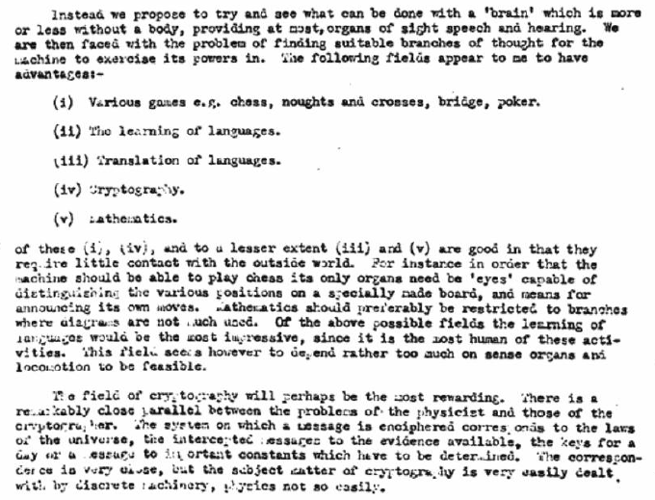

Alan Turing, on Thinking Machines

Slide 39
Alan Turing, on Thinking Machines

Slide 40
Alan Turing, on Thinking Machines

Slide 41
Alan Turing, on Thinking Machines

Slide 42
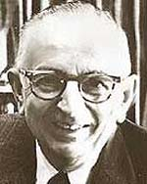
Statistical Machine Translation
"When I look at an article in Russian, I say: this is really written in English, but it has been coded in some strange symbols. I will now proceed to decode." -- Warren Weaver (1947)
Weaver saw a colleague decoding intercepts into
Turkish, without "knowing" Turkish.
… maybe a computer could translate into English without "knowing" English?
OUR HERO

Slide 43

Statistical Machine Translation
Hmm, every time he sees
"banco", he either types
"bank" or "bench" … but if
he sees "banco de…",
he always types "bank",
never "bench"…
Translate, translate …
Translated, parallel
documents

Slide 44
Parallel Corpus
12 English sentences in English and Spanish.
1a. Garcia and associates .
1b. Garcia y asociados .
7a. the clients and the associates are enemies .
7b. los clients y los asociados son enemigos .
2a. Carlos Garcia has three associates .
2b. Carlos Garcia tiene tres asociados .
8a. the company has three groups .
8b. la empresa tiene tres grupos .
3a. his associates are not strong .
3b. sus asociados no son fuertes .
9a. its groups are in Europe .
9b. sus grupos estan en Europa .
4a. Garcia has a company also .
4b. Garcia tambien tiene una empresa .
10a. the modern groups sell strong pharmaceuticals .
10b. los grupos modernos venden medicinas fuertes .
5a. its clients are angry .
5b. sus clientes estan enfadados .
11a. the groups do not sell zenzanine .
11b. los grupos no venden zanzanina .
6a. the associates are also angry .
6b. los asociados tambien estan enfadados .
12a. the small groups are not modern .
12b. los grupos pequenos no son modernos .

Slide 45
Parallel Corpus
12 English sentences in Centauri and Arcturan.
1a. ok-voon ororok sprok .
1b. at-voon bichat dat .
7a. lalok farok ororok lalok sprok izok enemok .
7b. wat jjat bichat wat dat vat eneat .
2a. ok-drubel ok-voon anok plok sprok .
2b. at-drubel at-voon pippat rrat dat .
8a. lalok brok anok plok nok .
8b. iat lat pippat rrat nnat .
3a. erok sprok izok hihok ghirok .
3b. totat dat arrat vat hilat .
9a. wiwok nok izok kantok ok-yurp .
9b. totat nnat quat oloat at-yurp .
4a. ok-voon anok drok brok jok .
4b. at-voon krat pippat sat lat .
10a. lalok mok nok yorok ghirok clok .
10b. wat nnat gat mat bat hilat .
5a. wiwok farok izok stok .
5b. totat jjat quat cat .
11a. lalok nok crrrok hihok yorok zanzanok .
11b. wat nnat arrat mat zanzanat .
6a. lalok sprok izok jok stok .
6b. wat dat krat quat cat .
12a. lalok rarok nok izok hihok mok .
12b. wat nnat forat arrat vat gat .

Slide 46
Centauri/Arcturan
Your assignment, translate this to Arcturan: farok crrrok hihok yorok clok kantok ok-yurp
1a. ok-voon ororok sprok .
1b. at-voon bichat dat .
7a. lalok farok ororok lalok sprok izok enemok .
7b. wat jjat bichat wat dat vat eneat .
2a. ok-drubel ok-voon anok plok sprok .
2b. at-drubel at-voon pippat rrat dat .
8a. lalok brok anok plok nok .
8b. iat lat pippat rrat nnat .
3a. erok sprok izok hihok ghirok .
3b. totat dat arrat vat hilat .
9a. wiwok nok izok kantok ok-yurp .
9b. totat nnat quat oloat at-yurp .
4a. ok-voon anok drok brok jok .
4b. at-voon krat pippat sat lat .
10a. lalok mok nok yorok ghirok clok .
10b. wat nnat gat mat bat hilat .
5a. wiwok farok izok stok .
5b. totat jjat quat cat .
11a. lalok nok crrrok hihok yorok zanzanok .
11b. wat nnat arrat mat zanzanat .
6a. lalok sprok izok jok stok .
6b. wat dat krat quat cat .
12a. lalok rarok nok izok hihok mok .
12b. wat nnat forat arrat vat gat .

Slide 47
Centauri/Arcturan
Your assignment, translate this to Arcturan: farok crrrok hihok yorok clok kantok ok-yurp
1a. ok-voon ororok sprok .
1b. at-voon bichat dat .
7a. lalok farok ororok lalok sprok izok enemok .
7b. wat jjat bichat wat dat vat eneat .
2a. ok-drubel ok-voon anok plok sprok .
2b. at-drubel at-voon pippat rrat dat .
8a. lalok brok anok plok nok .
8b. iat lat pippat rrat nnat .
3a. erok sprok izok hihok ghirok .
3b. totat dat arrat vat hilat .
9a. wiwok nok izok kantok ok-yurp .
9b. totat nnat quat oloat at-yurp .
4a. ok-voon anok drok brok jok .
4b. at-voon krat pippat sat lat .
10a. lalok mok nok yorok ghirok clok .
10b. wat nnat gat mat bat hilat .
5a. wiwok farok izok stok .
5b. totat jjat quat cat .
11a. lalok nok crrrok hihok yorok zanzanok .
11b. wat nnat arrat mat zanzanat .
6a. lalok sprok izok jok stok .
6b. wat dat krat quat cat .
12a. lalok rarok nok izok hihok mok .
12b. wat nnat forat arrat vat gat .

Slide 48
Centauri/Arcturan
Your assignment, translate this to Arcturan: farok crrrok hihok yorok clok kantok ok-yurp
1a. ok-voon ororok sprok .
1b. at-voon bichat dat .
7a. lalok farok ororok lalok sprok izok enemok .
7b. wat jjat bichat wat dat vat eneat .
2a. ok-drubel ok-voon anok plok sprok .
2b. at-drubel at-voon pippat rrat dat .
8a. lalok brok anok plok nok .
8b. iat lat pippat rrat nnat .
3a. erok sprok izok hihok ghirok .
3b. totat dat arrat vat hilat .
9a. wiwok nok izok kantok ok-yurp .
9b. totat nnat quat oloat at-yurp .
4a. ok-voon anok drok brok jok .
4b. at-voon krat pippat sat lat .
10a. lalok mok nok yorok ghirok clok .
10b. wat nnat gat mat bat hilat .
5a. wiwok farok izok stok .
5b. totat jjat quat cat .
11a. lalok nok crrrok hihok yorok zanzanok .
11b. wat nnat arrat mat zanzanat .
6a. lalok sprok izok jok stok .
6b. wat dat krat quat cat .
12a. lalok rarok nok izok hihok mok .
12b. wat nnat forat arrat vat gat .

Slide 49
Centauri/Arcturan
Your assignment, translate this to Arcturan: farok crrrok hihok yorok clok kantok ok-yurp
1a. ok-voon ororok sprok .
1b. at-voon bichat dat .
7a. lalok farok ororok lalok sprok izok enemok .
7b. wat jjat bichat wat dat vat eneat .
2a. ok-drubel ok-voon anok plok sprok .
2b. at-drubel at-voon pippat rrat dat .
8a. lalok brok anok plok nok .
8b. iat lat pippat rrat nnat .
3a. erok sprok izok hihok ghirok .
3b. totat dat arrat vat hilat .
9a. wiwok nok izok kantok ok-yurp .
9b. totat nnat quat oloat at-yurp .
4a. ok-voon anok drok brok jok .
4b. at-voon krat pippat sat lat .
10a. lalok mok nok yorok ghirok clok .
10b. wat nnat gat mat bat hilat .
5a. wiwok farok izok stok .
5b. totat jjat quat cat .
11a. lalok nok crrrok hihok yorok zanzanok .
11b. wat nnat arrat mat zanzanat .
???
6a. lalok sprok izok jok stok .
6b. wat dat krat quat cat .
12a. lalok rarok nok izok hihok mok .
12b. wat nnat forat arrat vat gat .

Slide 50
Centauri/Arcturan
Your assignment, translate this to Arcturan: farok crrrok hihok yorok clok kantok ok-yurp
1a. ok-voon ororok sprok .
1b. at-voon bichat dat .
7a. lalok farok ororok lalok sprok izok enemok .
7b. wat jjat bichat wat dat vat eneat .
2a. ok-drubel ok-voon anok plok sprok .
2b. at-drubel at-voon pippat rrat dat .
8a. lalok brok anok plok nok .
8b. iat lat pippat rrat nnat .
3a. erok sprok izok hihok ghirok .
3b. totat dat arrat vat hilat .
9a. wiwok nok izok kantok ok-yurp .
9b. totat nnat quat oloat at-yurp .
4a. ok-voon anok drok brok jok .
4b. at-voon krat pippat sat lat .
10a. lalok mok nok yorok ghirok clok .
10b. wat nnat gat mat bat hilat .
5a. wiwok farok izok stok .
5b. totat jjat quat cat .
11a. lalok nok crrrok hihok yorok zanzanok .
11b. wat nnat arrat mat zanzanat .
6a. lalok sprok izok jok stok .
6b. wat dat krat quat cat .
12a. lalok rarok nok izok hihok mok .
12b. wat nnat forat arrat vat gat .

Slide 51
Centauri/Arcturan
Your assignment, translate this to Arcturan: farok crrrok hihok yorok clok kantok ok-yurp
1a. ok-voon ororok sprok .
1b. at-voon bichat dat .
7a. lalok farok ororok lalok sprok izok enemok .
7b. wat jjat bichat wat dat vat eneat .
2a. ok-drubel ok-voon anok plok sprok .
2b. at-drubel at-voon pippat rrat dat .
8a. lalok brok anok plok nok .
8b. iat lat pippat rrat nnat .
3a. erok sprok izok hihok ghirok .
3b. totat dat arrat vat hilat .
9a. wiwok nok izok kantok ok-yurp .
9b. totat nnat quat oloat at-yurp .
4a. ok-voon anok drok brok jok .
4b. at-voon krat pippat sat lat .
10a. lalok mok nok yorok ghirok clok .
10b. wat nnat gat mat bat hilat .
5a. wiwok farok izok stok .
5b. totat jjat quat cat .
11a. lalok nok crrrok hihok yorok zanzanok .
11b. wat nnat arrat mat zanzanat .
6a. lalok sprok izok jok stok .
6b. wat dat krat quat cat .
12a. lalok rarok nok izok hihok mok .
12b. wat nnat forat arrat vat gat .

Slide 52
Centauri/Arcturan
Your assignment, translate this to Arcturan: farok crrrok hihok yorok clok kantok ok-yurp
1a. ok-voon ororok sprok .
1b. at-voon bichat dat .
7a. lalok farok ororok lalok sprok izok enemok .
7b. wat jjat bichat wat dat vat eneat .
2a. ok-drubel ok-voon anok plok sprok .
2b. at-drubel at-voon pippat rrat dat .
8a. lalok brok anok plok nok .
8b. iat lat pippat rrat nnat .
3a. erok sprok izok hihok ghirok .
3b. totat dat arrat vat hilat .
9a. wiwok nok izok kantok ok-yurp .
9b. totat nnat quat oloat at-yurp .
4a. ok-voon anok drok brok jok .
4b. at-voon krat pippat sat lat .
10a. lalok mok nok yorok ghirok clok .
10b. wat nnat gat mat bat hilat .
5a. wiwok farok izok stok .
5b. totat jjat quat cat .
11a. lalok nok crrrok hihok yorok zanzanok .
11b. wat nnat arrat mat zanzanat .
6a. lalok sprok izok jok stok .
6b. wat dat krat quat cat .
12a. lalok rarok nok izok hihok mok .
12b. wat nnat forat arrat vat gat .

Slide 53
Centauri/Arcturan
Your assignment, translate this to Arcturan: farok crrrok hihok yorok clok kantok ok-yurp
1a. ok-voon ororok sprok .
1b. at-voon bichat dat .
7a. lalok farok ororok lalok sprok izok enemok .
7b. wat jjat bichat wat dat vat eneat .
2a. ok-drubel ok-voon anok plok sprok .
2b. at-drubel at-voon pippat rrat dat .
8a. lalok brok anok plok nok .
8b. iat lat pippat rrat nnat .
3a. erok sprok izok hihok ghirok .
3b. totat dat arrat vat hilat .
9a. wiwok nok izok kantok ok-yurp .
9b. totat nnat quat oloat at-yurp .
4a. ok-voon anok drok brok jok .
4b. at-voon krat pippat sat lat .
10a. lalok mok nok yorok ghirok clok .
10b. wat nnat gat mat bat hilat .
???
5a. wiwok farok izok stok .
5b. totat jjat quat cat .
11a. lalok nok crrrok hihok yorok zanzanok .
11b. wat nnat arrat mat zanzanat .
6a. lalok sprok izok jok stok .
6b. wat dat krat quat cat .
12a. lalok rarok nok izok hihok mok .
12b. wat nnat forat arrat vat gat .

Slide 54
Centauri/Arcturan
Your assignment, translate this to Arcturan: farok crrrok hihok yorok clok kantok ok-yurp
1a. ok-voon ororok sprok .
1b. at-voon bichat dat .
7a. lalok farok ororok lalok sprok izok enemok .
7b. wat jjat bichat wat dat vat eneat .
2a. ok-drubel ok-voon anok plok sprok .
2b. at-drubel at-voon pippat rrat dat .
8a. lalok brok anok plok nok .
8b. iat lat pippat rrat nnat .
3a. erok sprok izok hihok ghirok .
3b. totat dat arrat vat hilat .
9a. wiwok nok izok kantok ok-yurp .
9b. totat nnat quat oloat at-yurp .
4a. ok-voon anok drok brok jok .
4b. at-voon krat pippat sat lat .
10a. lalok mok nok yorok ghirok clok .
10b. wat nnat gat mat bat hilat .
5a. wiwok farok izok stok .
5b. totat jjat quat cat .
11a. lalok nok crrrok hihok yorok zanzanok .
11b. wat nnat arrat mat zanzanat .
6a. lalok sprok izok jok stok .
6b. wat dat krat quat cat .
12a. lalok rarok nok izok hihok mok .
12b. wat nnat forat arrat vat gat .

Slide 55
Centauri/Arcturan
Your assignment, translate this to Arcturan: farok crrrok hihok yorok clok kantok ok-yurp
1a. ok-voon ororok sprok .
1b. at-voon bichat dat .
7a. lalok farok ororok lalok sprok izok enemok .
7b. wat jjat bichat wat dat vat eneat .
2a. ok-drubel ok-voon anok plok sprok .
2b. at-drubel at-voon pippat rrat dat .
8a. lalok brok anok plok nok .
8b. iat lat pippat rrat nnat .
3a. erok sprok izok hihok ghirok .
3b. totat dat arrat vat hilat .
9a. wiwok nok izok kantok ok-yurp .
9b. totat nnat quat oloat at-yurp .
4a. ok-voon anok drok brok jok .
4b. at-voon krat pippat sat lat .
10a. lalok mok nok yorok ghirok clok .
10b. wat nnat gat mat bat hilat .
process of
elimination
5a. wiwok farok izok stok .
5b. totat jjat quat cat .
11a. lalok nok crrrok hihok yorok zanzanok .
11b. wat nnat arrat mat zanzanat .
6a. lalok sprok izok jok stok .
6b. wat dat krat quat cat .
12a. lalok rarok nok izok hihok mok .
12b. wat nnat forat arrat vat gat .

Slide 56
Learn Translation Knowledge from Non-Parallel Text?
English/Albanian
Parallel text
English
text
Albanian
text
Translation model
Translation model
Is this what Weaver had in mind?
We’ll come back to this idea.

Slide 57
Automatic decipherment

Slide 58
Letter Substitution Cipher
ciphertext c

Slide 59
Letter Substitution Cipher
plaintext p
ciphertext c
P(p)
P(c | p)
"key"

Slide 60
Letter Substitution Cipher
plaintext samples,
unrelated to ciphertext
plaintext p
ciphertext c
P(p)
P(c | p)
"key"

Slide 61
Letter Substitution Cipher
plaintext samples,
unrelated to ciphertext
FREEZE
plaintext p
ciphertext c
P(p)
P(c | p)
"key"

Slide 62
Letter Substitution Cipher
FREEZE
plaintext p
ciphertext c
P(p)
P(c | p)
"key"

Slide 63
Letter Substitution Cipher
Find substitution-table values
that maximize
P(c) = Σ_{p} P(p, c)
= Σ_{p} P(p) P(c | p)
ciphertext c
FREEZE
plaintext p
ciphertext c
P(p)
P(c | p)
"key"

Slide 64
Letter Substitution Cipher
Find substitution-table values
that maximize
P(c) = Σ_{p} P(p, c)
= Σ_{p} P(p) P(c | p)
ciphertext c
FREEZE
plaintext p
FREEZE
ciphertext c
P(p)
P(c | p)
"key"
best guess
plaintext p
DECODE
Find plaintext p that maximizes
P(p | c) ∼ P(p) P(c | p)

Slide 65
Letter Substitution Cipher
Find substitution-table values
that maximize
P(c) = Σ_{p} P(p, c)
= Σ_{p} P(p) P(c | p)
plaintext samples,
unrelated to ciphertext
ciphertext c
LM
EM
plaintext p
ciphertext c
P(p)
P(c | p)
"key"
best guess
plaintext p
Viterbi
Find plaintext p that maximizes
P(p | c) ∼ P(p) P(c | p)

Slide 66
Decipherment Accuracy vs. Cipher Length
2-gram
3-gram

Slide 67
Letter Substitution Cipher
Find substitution-table values
that maximize
P(c) = Σ_{p} P(p, c)
= Σ_{p} P(p)^{0.5} P(c | p)
plaintext samples,
unrelated to ciphertext
ciphertext c
LM
EM
[Ravi & Knight 09b]
plaintext p
ciphertext c
P(p)
P(c | p)
"key"
best guess
plaintext p
Viterbi
Find plaintext p that maximizes
P(p | c) ∼ P(p) P(c | p)³
[Knight/Yamada 99]

Slide 68
Reducing LM Weight During EM
Set EM to maximize
P(c) ≈ Σ_{p} P(p)^{0.5} P(c | p)
instead of
P(c) ≈ Σ_{p} P(p) P(c | p)
2-gram
3-gram
3-gram
7-gram
[Ravi & Knight 09b]

Slide 69
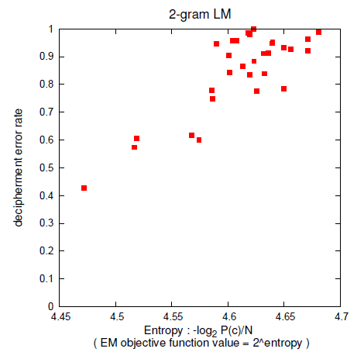
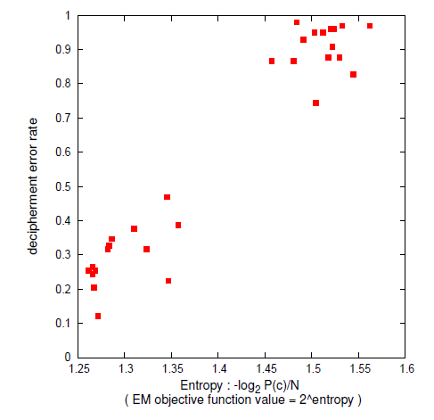
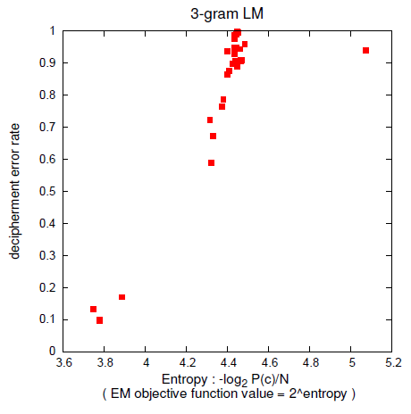
Random Restarts are Critical
English 98-letter cipher, 3-gram LM
Japanese
syllable
cipher
even people do restarts!
[Ravi & Knight 09b]

Slide 70
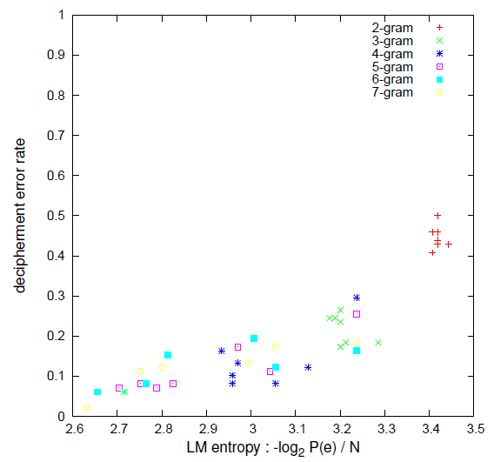
Good Language Models are Critical
English 98-letter cipher
[Ravi & Knight 09b]

Slide 71
Searching for Deterministic Keys
Peleg & Rosenfeld, 1979
relaxation search
...
Ravi & Knight, 2008
ILP, exact search
Corlett & Penn, 2010
A* exact search
Nuhn, Schamper, and Ney, 2013
beam search

Slide 72
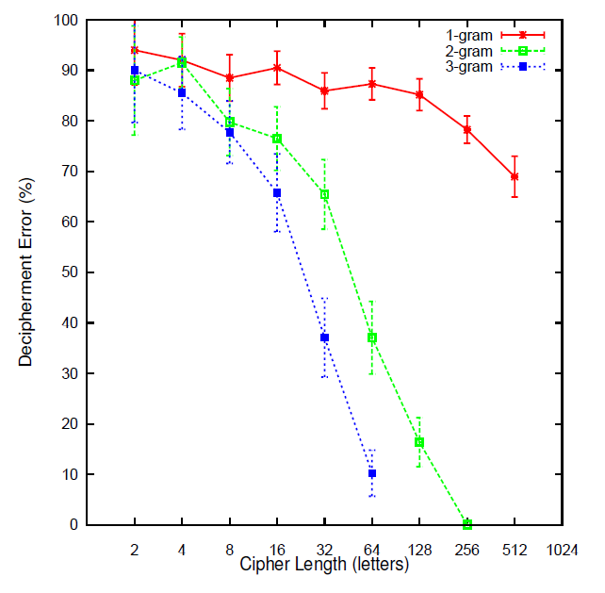
Deterministic Keys
* Use ILP to search only
deterministic keys.
* Exact, no restarts.
Cipher Length | EM error | ILP error
52 | 85 % | 21 %
98 | 45 % | 12 %
414 | 10 % | 0.5 %
[Ravi & Knight 08]
Using 2-gram letter-based LM

Slide 73
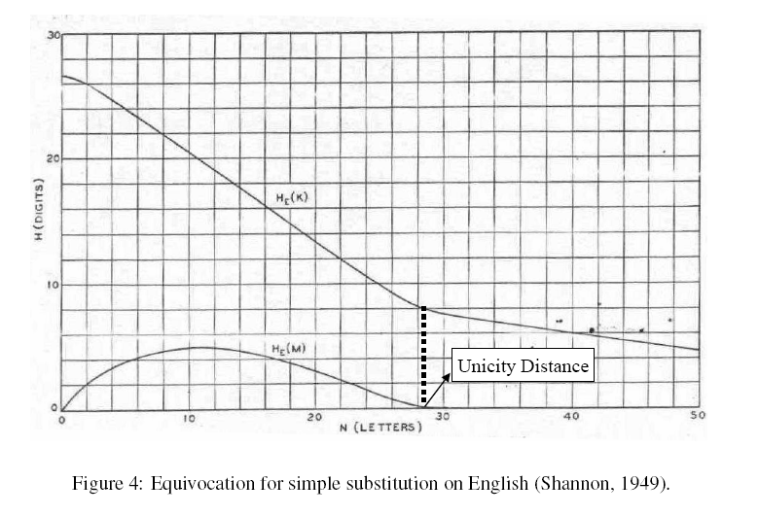
[Shannon 46, 49] "Communication Theory of Secrecy Systems"
Shannon analytically predicted uncertainty about key and message
Graphed it for a human-level language model
Entropy of key, H(K|C)
Entropy of plaintext message, H(M|C)
ENTROPY
(DECIMAL DIGITS)
log₂ 26!
Unicity distance = H(K) / (4.7 – LMCE)
CIPHER LENGTH (LETTERS)
~1.6 bits/char
for a human

Slide 74
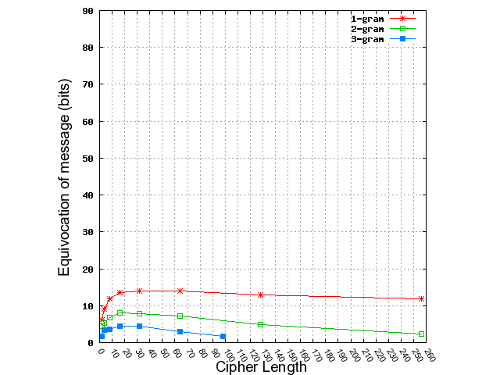
Verifying Shannon’s Prediction of Plaintext Message Uncertainty
LM | Analytically Predicted Unicity Distance
1-gram | 173
2-gram | 74
3-gram | 50
Human | 28
for Human Language Model
ANALYTIC CURVES (Shannon) ACTUAL CURVES
[Ravi & Knight 08]

Slide 75
Some Recent Historical Decipherments
Jefferson cipher (L. Smithline)
http://online.wsj.com/article/SB124648494429082661.html
For more than 200 years, buried deep within Thomas Jefferson's correspondence and papers, there lay a mysterious cipher -- a coded message that appears to have remained unsolved. Until now.
Civil War ciphers (K. Boklan)
Cryptologia, 30:340–345
We study a previously undeciphered Civil War cryptogram, limiting ourselves to pencil and paper, and discover not only a missive of military importance, but in the process identify a new Confederate codeword. Our methods rely not only upon cryptanalysis of the encryption method but also on the exploitation of an elementary mistake.
German Naval Enigma
http://www.enigma.hoerenberg.com
The "Breaking German Navy Ciphers" Project was founded in 2012. The goal is to break original radio messages, which were encoded with the famous German ENIGMA cipher machine. Up to now, we've succeeded in deciphering 53 original World War II Enigma M4 messages. Many of these messages had never been broken before, so you can read them for the first time in history.

Slide 76
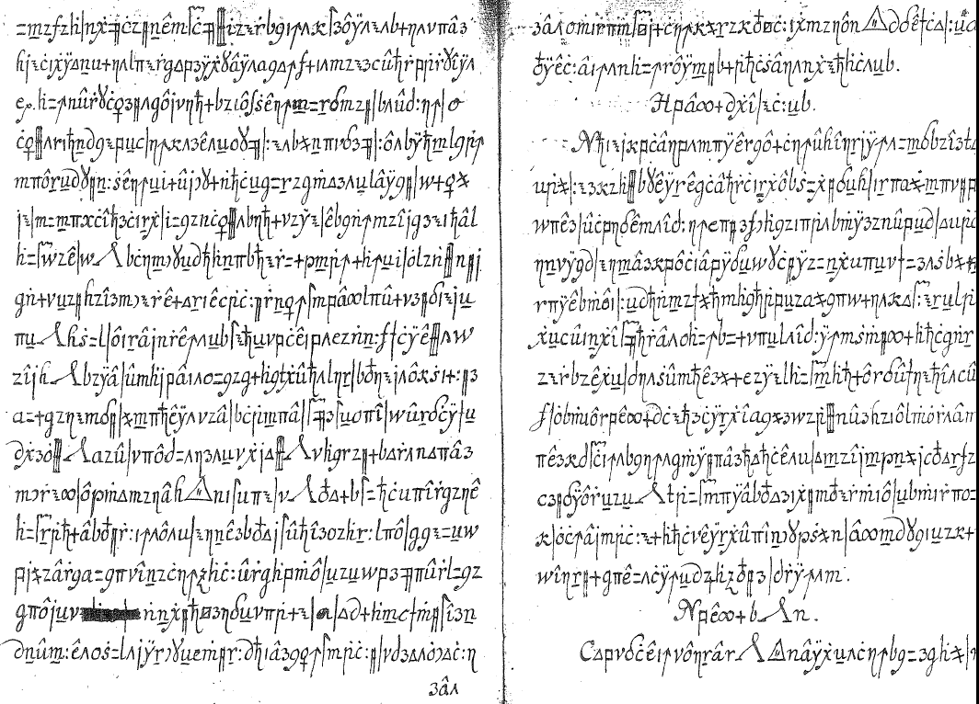
Copiale Cipher
[Knight, Megyesi, Schaefer 11]

Slide 77
Copiale Cipher
105 pages, 75000 letter tokens,
no word spacing, no illustrations.
Section headers
Lines ≈
equal length
Paragraphs and section titles
always begin with
capitalized Roman letters.
Non-enciphered inscriptions:
Copiales 3 and Philipp 1866
Some scratch-outs, rare
Preview text fragments
("catchwords")

Slide 78
Letter Frequencies
digraphs: trigraphs:
? - 99 ? - ^ 47
C : 66 C : G 23
- ^ 49 Y ? - 22
: G 48 y ? - 18
z ) 44 H C | 17
tendencies:
A, E, I, O, U followed by 3 and j
A, E, I, O, U preceded by z and >

Slide 79
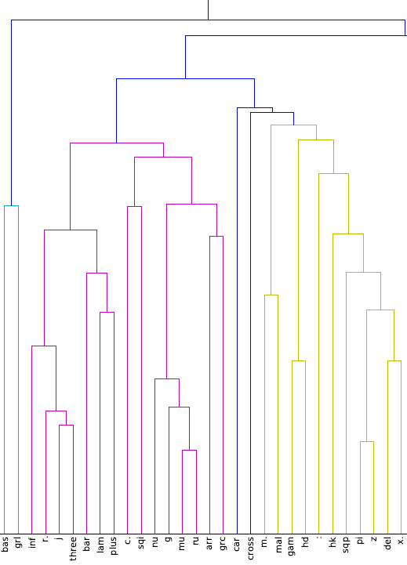
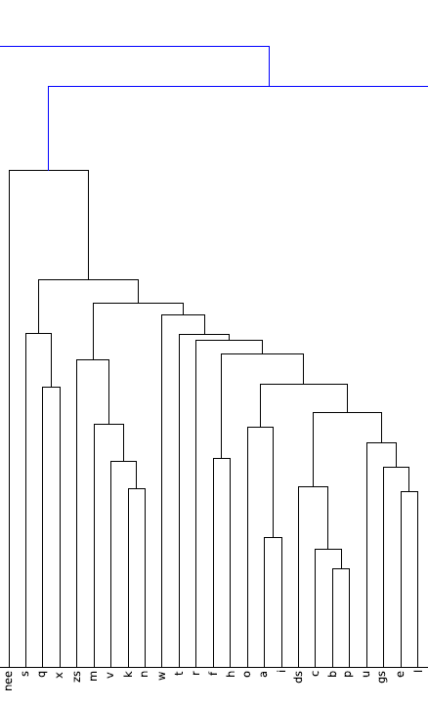
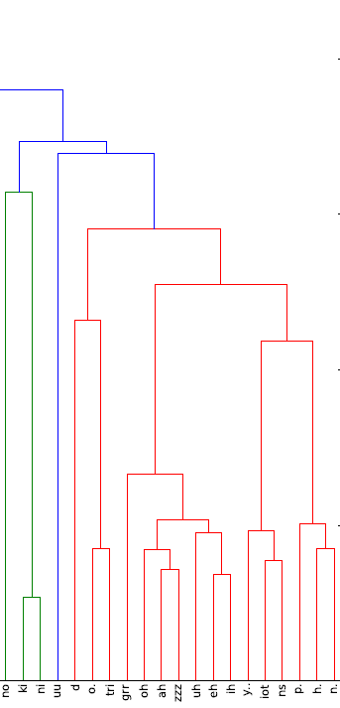
Clustering of Cipher Letters
letters grouped if they have similar contexts (L/R neighbors)
Scipy software
?]8R j 3 |^+C~DgBF/[4TM15-: 7Q >z6X9s qxJmvknwtrfhoai Lc bp uKei W"=Gd&<)OAZUEI y!Y PHN
thanks Jon Graehl

Slide 80
Clustering of Cipher Letters
letters grouped if they have similar contexts (L/R neighbors)
Scipy software
?]8R j 3 |^+C~DgBF/[4TM15-: 7Q >z6X9s qxJmvknwtrfhoai Lc bp uKei W"=Gd&<)OAZUEI y!Y PHN
underlined
letters
unaccented
Roman letters
circumflexed
vowels
thanks Jon Graehl

Slide 81
First Decipherment Approach
unaccented Roman
letters that cluster:
kMUF:pz!Of|y?-Ej-Z!^n>A3b#Kz=
j/lzGp0C^ARgk^-]R-]^ZjnQI|<R6)^a
=gzw>yEc#r1<+bzYR!XyjIFzGf9J
>"j/LP=~|U^S"B6m|ZYgA|k-=^-|lXO
W~:FI^b!7uMyjzvzAjx?PB>!zH^c1&gK
zU+p4]DXE3gh^-]j-]^I3tN"|rOyBA
+hHFzO3DbSY+:ZRkPQ6)-<CU^K=Dzk
QZ8nz)3f-NF>JEyDK=F>K1<3nz)|k
>Yj!XyRIg>G9bK^!Tb6U~]-3O^ezYO
|URc~306^bY-BL
a b c L e f K h i
k l m n o p q r s
t u v w x ( J
most common letter = 12%
least common = very small
kfnKlknacbfJmk
lbuvcKhtrhbkKDkn
fKKnkbKbecb ...
Decipher against
80 plaintext languages.

Slide 82
First Decipherment Approach
unaccented Roman
letters that cluster:
kMUF:pz!Of|y?-Ej-Z!^n>A3b#Kz=
j/lzGp0C^ARgk^-]R-]^ZjnQI|<R6)^a
=gzw>yEc#r1<+bzYR!XyjIFzGf9J
>"j/LP=~|U^S"B6m|ZYgA|k-=^-|lXO
W~:FI^b!7uMyjzvzAjx?PB>!zH^c1&gK
zU+p4]DXE3gh^-]j-]^I3tN"|rOyBA
+hHFzO3DbSY+:ZRkPQ6)-<CU^K=Dzk
QZ8nz)3f-NF>JEyDK=F>K1<3nz)|k
>Yj!XyRIg>G9bK^!Tb6U~]-3O^ezYO
|URc~306^bY-BL
a b c L e f K h i
k l m n o p q r s
t u v w x ( J
most common letter = 12%
least common = very small
kfnKlknacbfJmk
lbuvcKhtrhbkKDkn
fKKnkbKbecb ...
FAIL
Decipher against
80 plaintext languages.

Slide 83
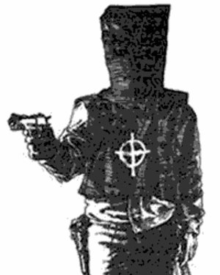
Second Decipherment Approach
Homophonic cipher,
e.g.:
A = 5 j l ( R
B = U
C = & D
D = ]
E = X f < " _ I Z 3
F = Q
G = y
etc.
kMUF:pz!Of|y?-Ej-Z!^n>A3b#Kz=
j/lzGp0C^ARgk^-]R-]^ZjnQI|<R6)^a
=gzw>yEc#r1<+bzYR!XyjIFzGf9J
>"j/LP=~|U^S"B6m|ZYgA|k-=^-|lXO
W~:FI^b!7uMyjzvzAjx?PB>!zH^c1&gK
zU+p4]DXE3gh^-]j-]^I3tN"|rOyBA
+hHFzO3DbSY+:ZRkPQ6)-<CU^K=Dzk
QZ8nz)3f-NF>JEyDK=F>K1<3nz)|k
>Yj!XyRIg>G9bK^!Tb6U~]-3O^ezYO
|URc~306^bY-BL

Slide 84
Homophonic Cipher
Result of computer attack on Copiale, using 80 possible plaintext languages?
FAIL
But, slight numerical preference for German

Slide 85
Cipher Characteristics
digraphs: trigraphs:
? - 99 ? - ^ 47
C : 66 C : G 23
- ^ 49 Y ? - 22
: G 48 y ? - 18
z ) 44 H C | 17
tendencies:
A, E, I, O, U followed by 3 and j
A, E, I, O, U preceded by z and >
?
?
should appear
adjacent in German text
Make full digraph table for cipher and for German

Slide 86
Key Observation #1
In Copiale, ? almost always followed by –
In German, C almost always followed by H
(German CH is like English QU)
So guess: ? = C, –= H

Slide 87
One Thing Leads to Another
?–= CH → ?–^ = CHT → ^ = T ?
Each step is guesswork.
Must be willing to retract.
Weird task, not knowing German.
No longer care what the book says.
Cluster diagram crucial:
y = I → ! = I , Y = I
W"=Gd&<)OAZUEI y!Y PHN

Slide 88
Spring Break
2011

Slide 89
Spring Break
2011
German letters
Cipher
letters,
in groups
Grid

Slide 90
Spring Break
2011
German letters
Cipher
letters,
in groups
Grid
Quite a bit
of fooling
around →

Slide 91
Spring Break
2011
German letters
German
trigraphs
Cipher
trigraphs
Cipher
letters,
in groups
Grid
Trigraph
Decoding
Guesses
Quite a bit
of fooling
around →

Slide 92
Key Observation #2
unaccented Roman
letters that cluster:
kMUF:pz!Of|y?-Ej-Z!^n>A3b#Kz=
j/lzGp0C^ARgk^-]R-]^ZjnQI|<R6)^a
=gzw>yEc#r1<+bzYR!XyjIFzGf9J
>"j/LP=~|U^S"B6m|ZYgA|k-=^-|lXO
W~:FI^b!7uMyjzvzAjx?PB>!zH^c1&gK
zU+p4]DXE3gh^-]j-]^I3tN"|rOyBA
+hHFzO3DbSY+:ZRkPQ6)-<CU^K=Dzk
QZ8nz)3f-NF>JEyDK=F>K1<3nz)|k
>Yj!XyRIg>G9bK^!Tb6U~]-3O^ezYO
|URc~306^bY-BL
a b c L e f K h i
k l m n o p q r s
t u v w x ( J
Actually, those are space bars

Slide 93
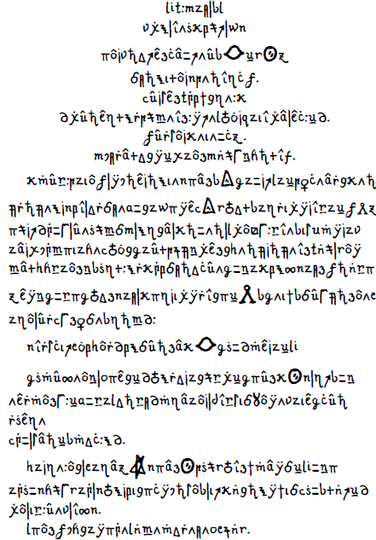
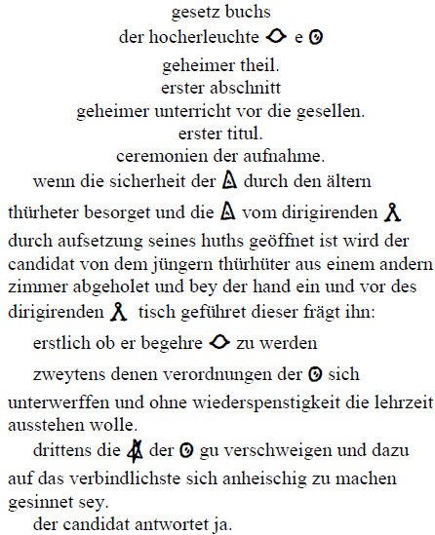
Copiale Decipherment

Slide 94
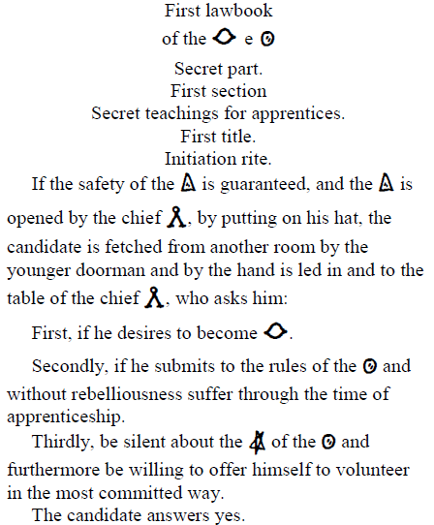
Copiale Decipherment

Slide 95
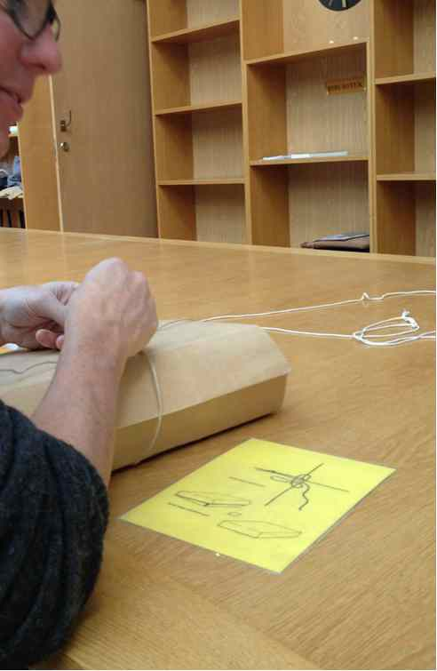

Historical Archives
?

Slide 96
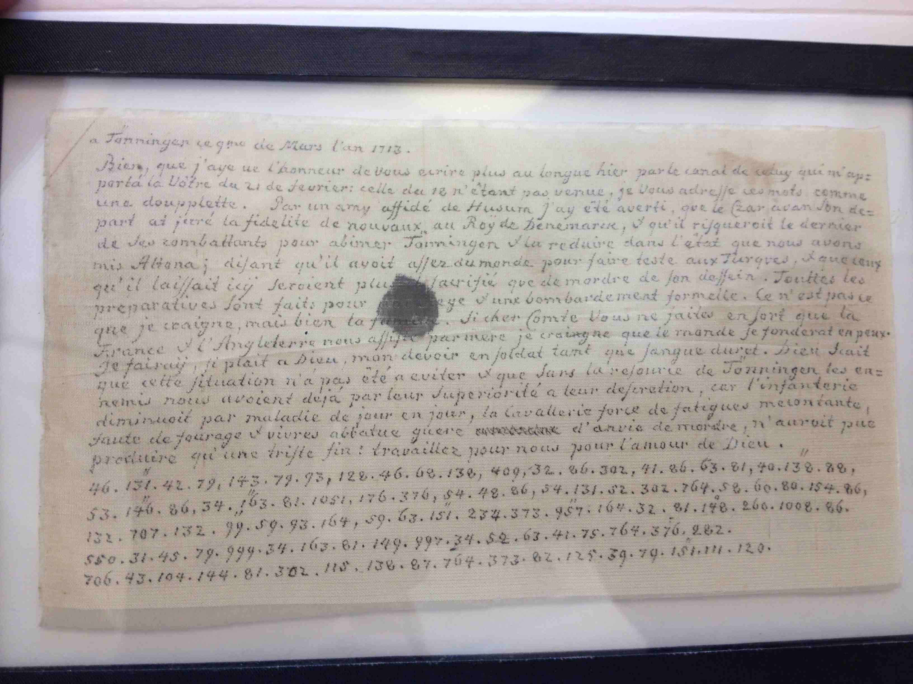
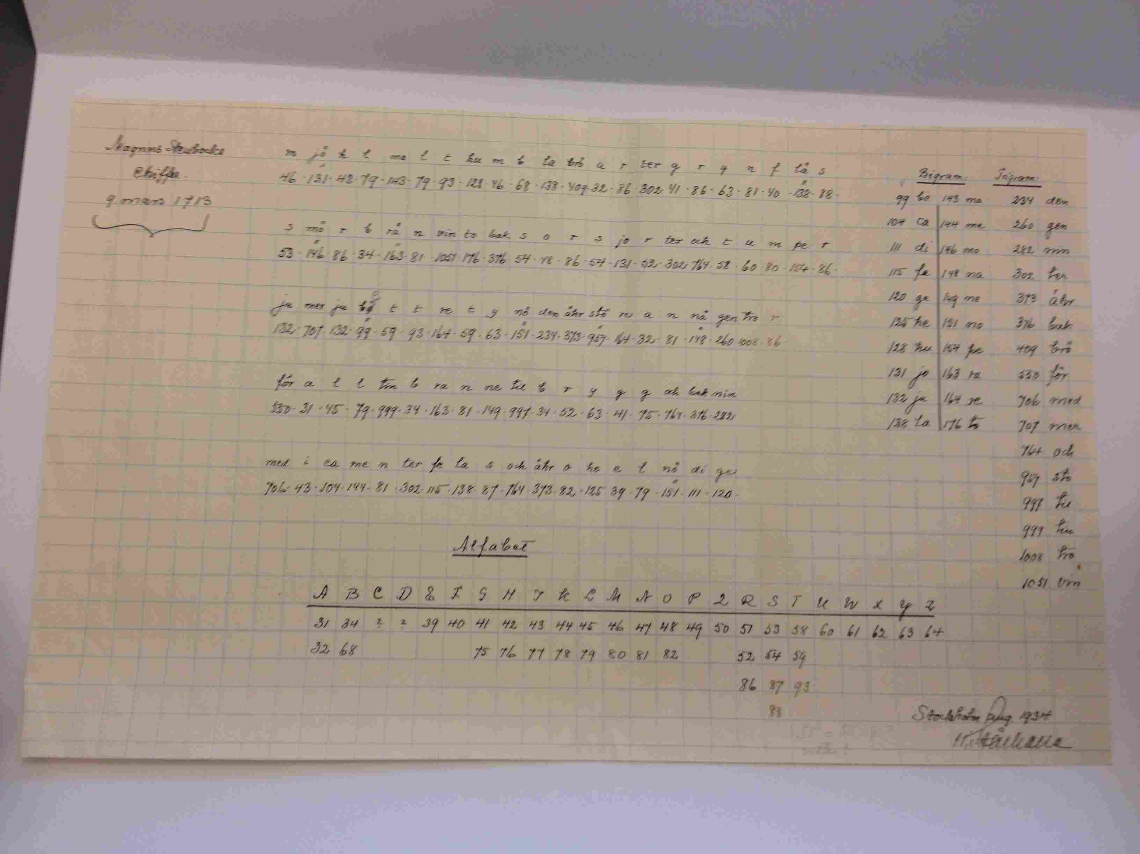
French plaintext
Ciphertext
Solution (1934)

Slide 97
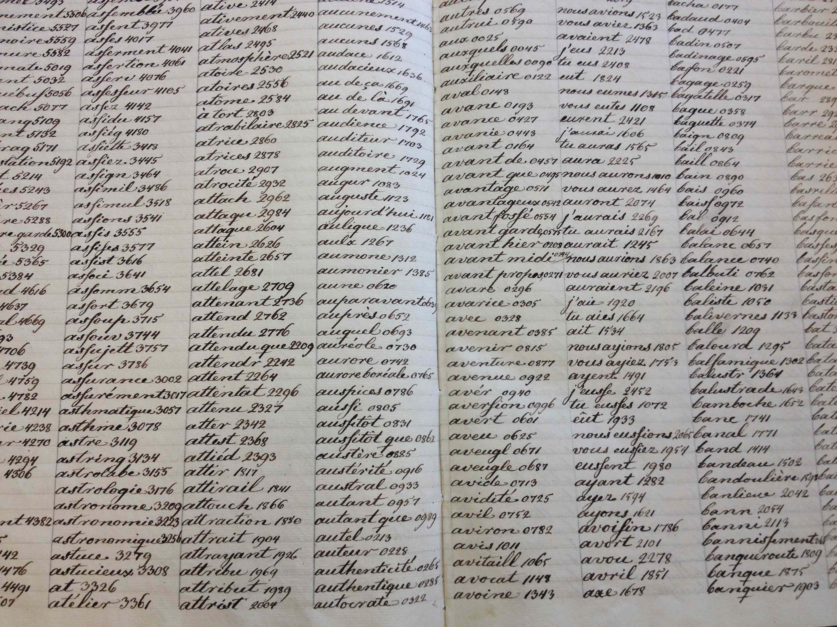
Word Substitution Encipherment Key

Slide 98
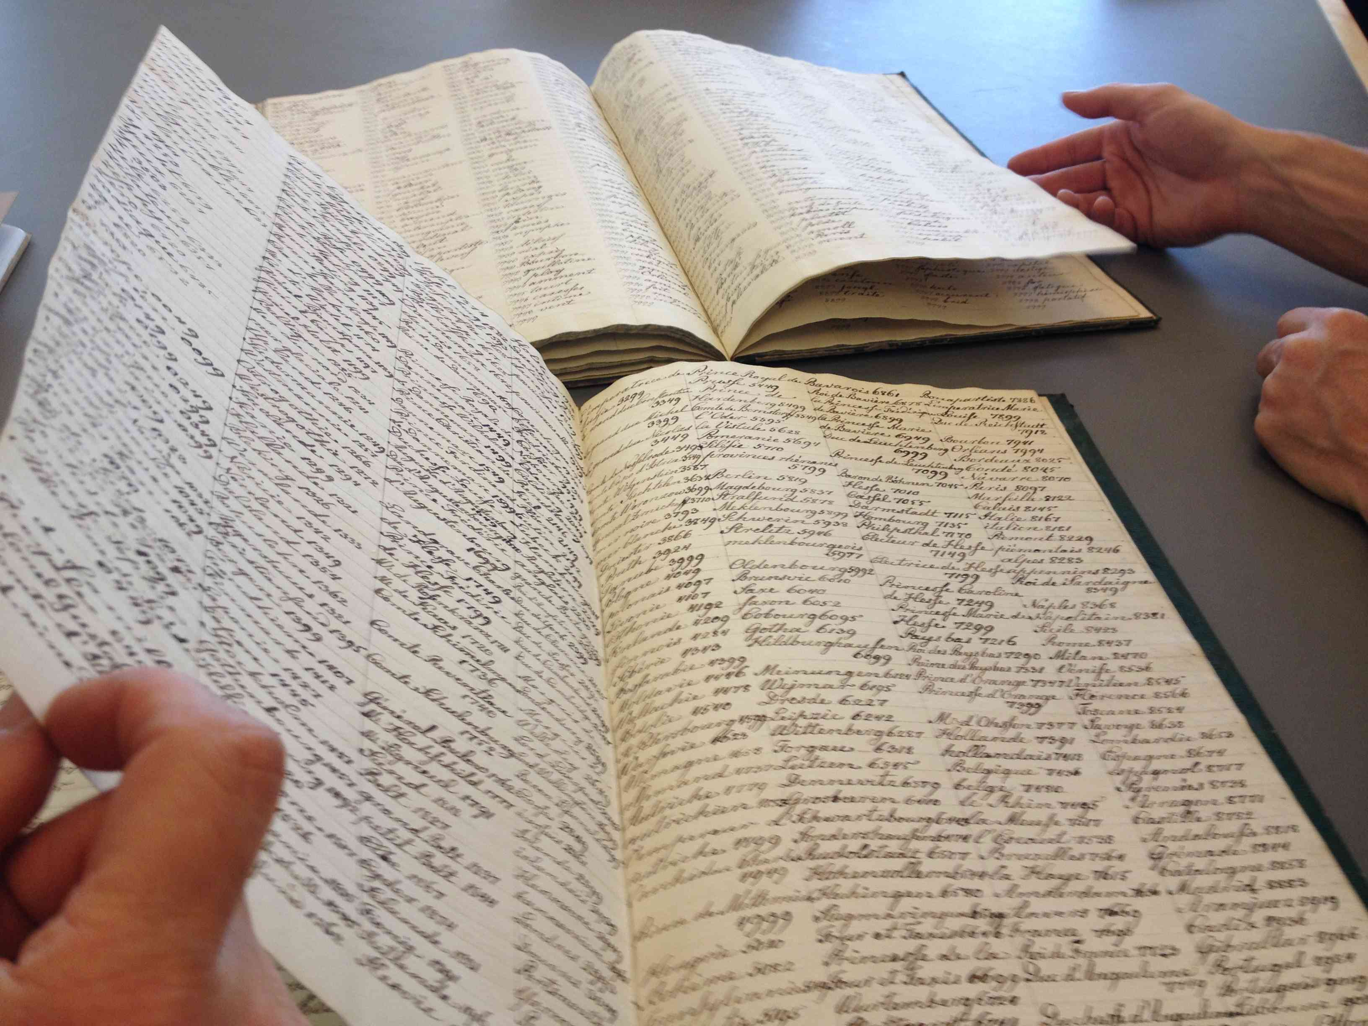
Word Substitution Keys
Decipherment Key
Encipherment Key

Slide 99
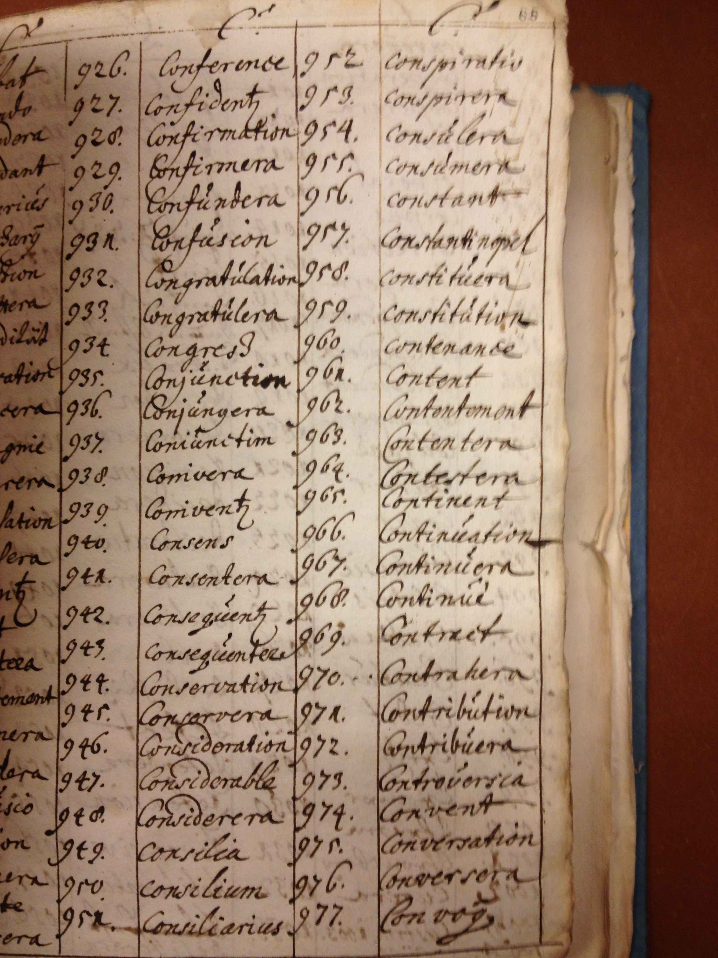
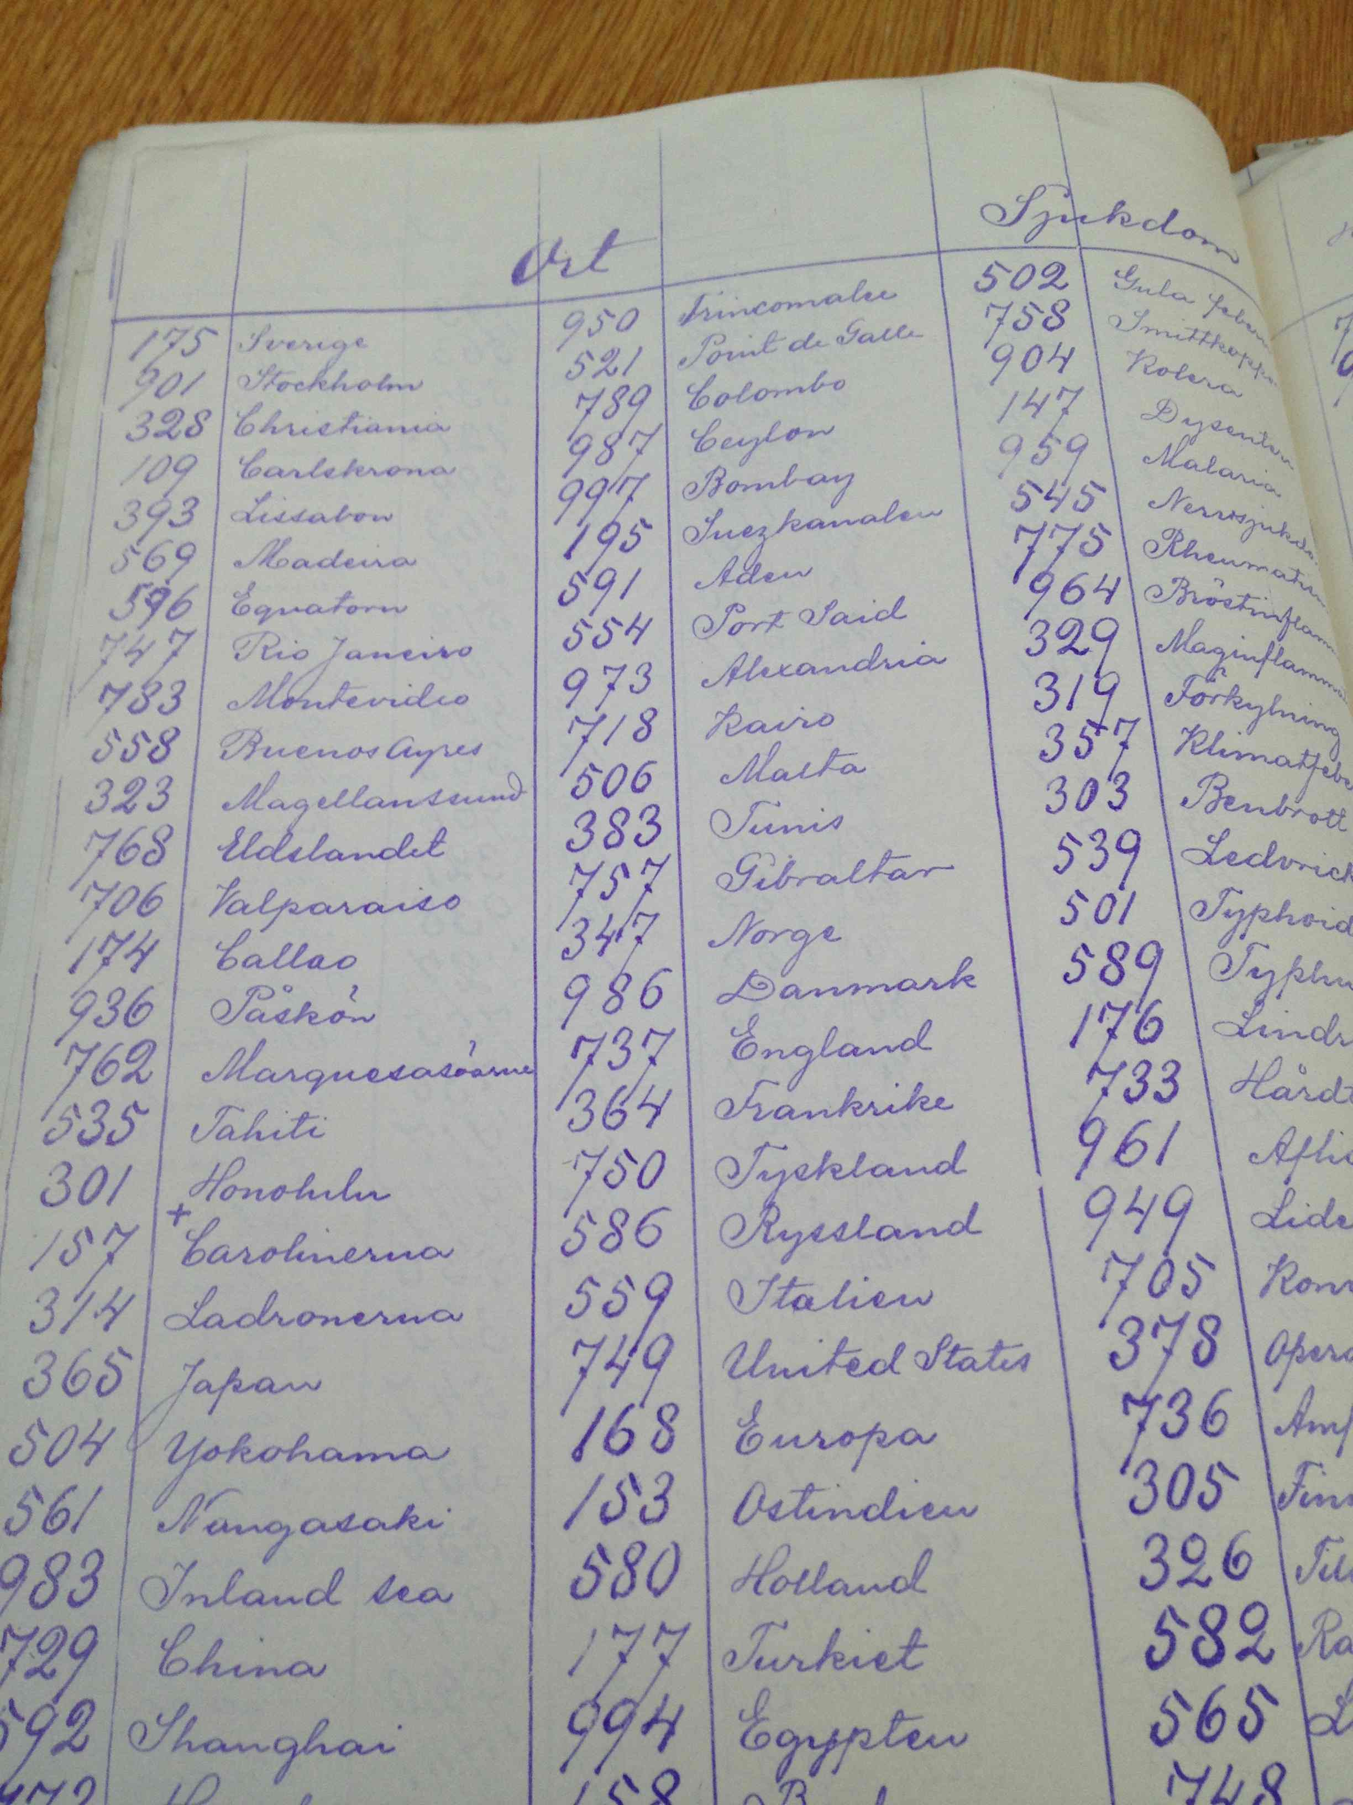
Word Substitution Keys
Numbers/Words Both
in Order!
Neither in Order!

Slide 100
Word Substitution
Interesting for NLP
Language translation can be viewed as word substitution (and transposition)
Certainly, that is how IBM models 1-5 view it

Slide 101
Word Substitution (Small-scale)
………….France………Britain………………Canada……………Mexico………………Indonesia……Malaysia……………….Britain………..Canada………..Australia……..Britain………….France…………….Indonesia………….Mexico………………Australia…………….France……Britain……………………………………….
Key Point: These texts are
not related to each other.
TRAIN
………….knd!………bryT!ny!………………knd!………………!lmksyk…………………….………!ndwnysy!……!lmksyk……………….bryT!ny…..!m!lyzy!………..bryT!ny!……..frns!………….!str!ly!…….!ndwnysy!………….frns!………………frns!……….frns!……bryT!ny!……………………!str!ly!……………
?
plaintext e
P(sentence has w1 |
sentence has w2)
P(f | e) =
7 x 7 subst table
[Knight et al 06]

Slide 102
Word Substitution (Small-scale)
………….France………Britain………………Canada……………Mexico………………Indonesia……Malaysia……………….Britain………..Canada………..Australia……..Britain………….France…………….Indonesia………….Mexico………………Australia…………….France……Britain……………………………………….
Key Point: These texts are
not related to each other.
TRAIN
………….knd!………bryT!ny!………………knd!………………!lmksyk…………………….………!ndwnysy!……!lmksyk……………….bryT!ny…..!m!lyzy!………..bryT!ny!……..frns!………….!str!ly!…….!ndwnysy!………….frns!………………frns!……….frns!……bryT!ny!……………………!str!ly!……………
?
plaintext e
P(sentence has w1 |
sentence has w2)
P(f | e) =
7 x 7 subst table
Australia → !str!ly! (0.93) !ndwnysy! (0.03) m!lyzy! (0.02)
Britain → bryT!ny! (0.98) !ndwnysy! (0.01) !str!ly! (0.01)
Canada → knd! (0.57) frns! (0.33) m!lyzy! (0.06)
France → frns! (1.00)
Indonesia → !ndwnysy! (1.00)
Malaysia → m!lyzy! (0.93) lmksyk (0.07)
Mexico → !lmksyk (0.91) m!lyzy! (0.07)
[Knight et al 06]

Slide 103
Word Substitution (Giga-scale)
Suppose I replace each English word on your hard drive with some integer.
Can you recover your texts?
In principle, apply the same techniques we used for letter substitution.
English word-bigram LM drives decipherment
But for EM, initially-uniform substitution table is too big!
100,000 x 100,000

Slide 104
Word Substitution (Giga-scale)
Gibbs sampling fixes memory problem
Slice sampling (Dou & Knight 12) fixes speed problem
Cipher: 24234 1899 39902 5716 29948 ...
Plain: the man is car are ...
Resample: a
an
apple
...
man
zoo
Still need to sample 100,000
alternatives at each cipher token,
for each epoch.

Slide 105
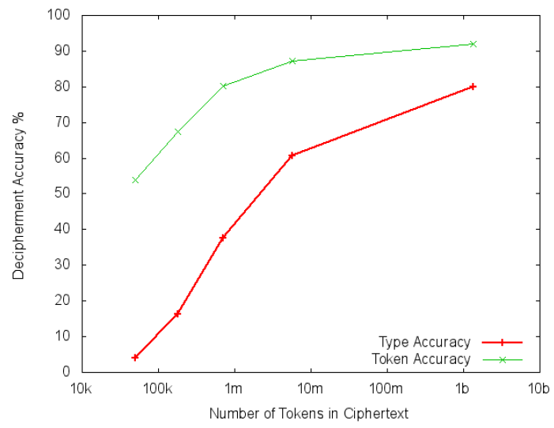
Word Substitution (Giga-scale)
(Dou & Knight 2011)

Slide 106
Foreign Language as a Cipher
"When I look at this giant corpus of Arabic, I say to myself, this is really English, but it has been encoded in some strange symbols!!! Let’s decode!!!"
OUR
HERO
رفض رئيس السلطة الفلسطينية محمود عباس مجددا تصريحات وزير الخارجية الإسرائيلي سيلفان شالوم التي قال فيها إنه يتعين على إسرائيل إعادة النظر في انسحابها من غزة، المقرر أن يتم الصيف المقبل إذا فازت حركة المقاومة الإسلامية حماس في الانتخابات التشريعية.
وقال عباس في مؤتمر صحفي على هامش مشاركته في القمة العربية-اللاتينية الأولى إنه يتعين على إسرائيل احترام خيار الشعب الفلسطيني حتى لو فازت حماس بالانتخابات، وأضاف "إذا نجحت حماس أو فتح سيكون هذا خيار الشعب الفلسطيني، وعلى الجميع قبول هذا الخيار بكل ترحاب".
من جانبه شجب رئيس الحكومة الفلسطينية أحمد قريع الطابع الأحادي الجانب للانسحاب الإسرائيلي من غزة، وأكد أن إسرائيل تريد مغادرة هذه الأراضي لتعزيز سيطرتها على الضفة الغربية.
وقال قريع في كلمة له خلال مؤتمر نظمته وزارة الأوقاف في رام الله "سينسحبون من غزة ولكننا لا نعرف ما هو شكل هذا الانسحاب وماذا سيتركون، وما هو مصير المعابر والحدود, وكل ذلك غامض لأنه قرار أحادي الجان
plaintext e
P(e)
P(f | e)

Slide 107
Foreign Language as a Cipher
BAGHDAD, Iraq (CNN) -- Six bombings killed at least 54 Iraqis and wounded 96 others Wednesday, including 20 civilians who died as they lined up to join the Iraqi army in Hawija when a suicide bomber detonated explosives hidden under his clothing, Iraqi officials said.
That attack in the town about 130 miles (209 kilometers) north of Baghdad also wounded 30 Iraqis, said Iraqi army Lt. Col. Khalil al-Zawbai.
A car bombing in Saddam Hussein's ancestral homeland of Tikrit also killed 30 Iraqis and wounded another 40, Iraqi officials said. The Tikrit explosion…
Key Point: These texts are
not related to each other.
TRAIN
رفض رئيس السلطة الفلسطينية محمود عباس مجددا تصريحات وزير الخارجية الإسرائيلي سيلفان شالوم التي قال فيها إنه يتعين على إسرائيل إعادة النظر في انسحابها من غزة، المقرر أن يتم الصيف المقبل إذا فازت حركة المقاومة الإسلامية حماس في الانتخابات التشريعية.
وقال عباس في مؤتمر صحفي على هامش مشاركته في القمة العربية-اللاتينية الأولى إنه يتعين على إسرائيل احترام خيار الشعب الفلسطيني حتى لو فازت حماس بالانتخابات، وأضاف "إذا نجحت حماس أو فتح سيكون هذا خيار الشعب الفلسطيني، وعلى الجميع قبول هذا الخيار بكل ترحاب".
من جانبه شجب رئيس الحكومة الفلسطينية أحمد قريع الطابع الأحادي الجانب للانسحاب الإسرائيلي من غزة، وأكد أن إسرائيل تريد مغادرة هذه الأراضي لتعزيز سيطرتها على الضفة الغربية.
وقال قريع في كلمة له خلال مؤتمر نظمته وزارة الأوقاف في رام الله "سينسحبون من غزة ولكننا لا نعرف ما هو شكل هذا الانسحاب وماذا سيتركون، وما هو مصير المعابر والحدود, وكل ذلك غامض لأنه قرار أحادي الجان
?
plaintext e
P(e)
P(f | e)

Slide 108
Time Expressions
!l@!m
!lywm
!lth!ny&
!l@!m !lm!Dy
Sfr
@!m
th!ny&
@!m 1992
@!m 1993
ywm
!l!sbw@ !lm!Dy
fy !ldqyq&
!lsn& !lj!ry&
!lsn&
!lsh=hr !lm!Dy
!lsh=hr !lj!ry
snw!t
sn&
=hdh! !l@!m
s!@&
!l@Sr
@!m 1991
!l@Swr
=hdh! !lsh=hr
fy ywm
nys!n
!sbw@
=hdh=h !l!'y!m
qbl !'y!m
fy !l@Sr
mn !lsn&
!lsnw!t
b@d ywm
!l!y!m
13 nys!n 1994
!lth!ny& @shr&
thl!th& !y!m
qbl !sbw@yn
fy !lywm !lt!ly
sh@b!n
tmwz
3 dhw !lHj& 1414
fy shb!T !lm!Dy
qbl ywmyn
@!m 1990
w!lth!ny&
fy !lywm
mn !lsh=hr !lj!ry
!lqrn
!'y!m
@!m!aN
!ls!@&
17 shb!T 1994
thl!th snw!t
dqyq&
=hdh=h !lsn&
ywmyn
mn !l@!m !lm!Dy
!lsn& !lmqbl&
fy !lsn&
kl ywm
fy !l@!m !lm!Dy

Slide 109
Time Expressions
!l@!m
!lywm
!lth!ny&
!l@!m !lm!Dy
Sfr
@!m
th!ny&
@!m 1992
@!m 1993
ywm
!l!sbw@ !lm!Dy
fy !ldqyq&
!lsn& !lj!ry&
!lsn&
!lsh=hr !lm!Dy
!lsh=hr !lj!ry
snw!t
sn&
=hdh! !l@!m
s!@&
!l@Sr
@!m 1991
!l@Swr
=hdh! !lsh=hr
fy ywm
nys!n
!sbw@
=hdh=h !l!'y!m
qbl !'y!m
fy !l@Sr
mn !lsn&
!lsnw!t
b@d ywm
!l!y!m
13 nys!n 1994
!lth!ny& @shr&
thl!th& !y!m
qbl !sbw@yn
fy !lywm !lt!ly
sh@b!n
tmwz
3 dhw !lHj& 1414
fy shb!T !lm!Dy
qbl ywmyn
@!m 1990
w!lth!ny&
fy !lywm
mn !lsh=hr !lj!ry
!lqrn
!'y!m
@!m!aN
!ls!@&
17 shb!T 1994
thl!th snw!t
dqyq&
=hdh=h !lsn&
ywmyn
mn !l@!m !lm!Dy
!lsn& !lmqbl&
fy !lsn&
kl ywm
fy !l@!m !lm!Dy

Slide 110
Time Expressions
<n><n>* ??? 19<n><n>
9 Hzyr!n 1942
8 tshryn !l!wl 1990
7 k!nwn !l!wl 1993
6 !'y!r 1993
6 !~Adh!r 1991
5 shb!T 1950
4 Hzyr!n 1989
30 !~Adh!r 1944
29 !y!r 1945
29 !~Adh!r 1993
28 k!nwn !l!'wl 1994
27 tmwz 1993
26 tmwz 1953
26 shb!T 1993
26 k!nwn !l!wl 1994
25 !ylwl 1926
24 !~Adh!r 1993
22 !ylwl 1957
22 tshryn !l!wl 1948
22 tmwz 1952
21 !y!r 1994
21 k!nwn !l!wl 1988
21 Hzyr!n 1967
20 !'y!r 1990
20 tshryn !'wl 1983
20 tshryn !l!'wl 1921
1 !y!r 1994
17 Hzyr!n 1972
16 !ylwl 1919
16 Hzyr!n 1984
16 !~Ab 1929

Slide 111
Time Expressions
<n> Hzyr!n <n>
13 4 Hzyr!n 1967
12 fy 12 Hzyr!n 1993
7 5 Hzyr!n 1967
6 fy 30 Hzyr!n 1989
6 30 Hzyr!n 1989
4 fy 30 Hzyr!n 1994
4 fy 30 Hzyr!n 1993
3 fy 19 Hzyr!n 1967
2 ywm 30 Hzyr!n 1989
2 w 6 Hzyr!n 1994
2 qbl 5 Hzyr!n 1967
2 fy 9 Hzyr!n 1967
2 fy 7 Hzyr!n 1981
2 fy 6 Hzyr!n 1994
2 fy 5 Hzyr!n 1967
2 fy 30 Hzyr!n 1995
2 fy 18 Hzyr!n 1994
2 fy 14 Hzyr!n 1993
2 fy 14 Hzyr!n 1991
2 fy 12 Hzyr!n 1990
2 7 Hzyr!n 1994
2 6 Hzyr!n 1941
2 26 Hzyr!n 1994
2 21 Hzyr!n 1994
2 1 Hzyr!n 1994
2 19 Hzyr!n 1965
2 18 Hzyr!n 1994
2 18 Hzyr!n 1940
2 12 Hzyr!n 1993
2 11 Hzyr!n 1994

Slide 112
Time Expressions
<n> Hzyr!n <n>
13 4 Hzyr!n 1967
12 fy 12 Hzyr!n 1993
7 5 Hzyr!n 1967
6 fy 30 Hzyr!n 1989
6 30 Hzyr!n 1989
4 fy 30 Hzyr!n 1994
4 fy 30 Hzyr!n 1993
3 fy 19 Hzyr!n 1967
2 ywm 30 Hzyr!n 1989
2 w 6 Hzyr!n 1994
2 qbl 5 Hzyr!n 1967
2 fy 9 Hzyr!n 1967
2 fy 7 Hzyr!n 1981
2 fy 6 Hzyr!n 1994
2 fy 5 Hzyr!n 1967
2 fy 30 Hzyr!n 1995
2 fy 18 Hzyr!n 1994
2 fy 14 Hzyr!n 1993
2 fy 14 Hzyr!n 1991
2 fy 12 Hzyr!n 1990
2 7 Hzyr!n 1994
2 6 Hzyr!n 1941
2 26 Hzyr!n 1994
2 21 Hzyr!n 1994
2 1 Hzyr!n 1994
2 19 Hzyr!n 1965
2 18 Hzyr!n 1994
2 18 Hzyr!n 1940
2 12 Hzyr!n 1993
2 11 Hzyr!n 1994

Slide 113
Time Expressions
Search query | Documents
January 4, 1967 | 8040
February 4, 1967 | 9270
March 4, 1967 | 10700
April 4, 1967 | 21800
May 4, 1967 | 14000
June 4, 1967 | 39300
July 4, 1967 | 12600
August 4, 1967 | 7970
September 4, 1967 | 7390
October 4, 1967 | 8800
November 4, 1967 | 6560
December 4, 1967 | 9770
<n> Hzyr!n <n>
13 4 Hzyr!n 1967
12 fy 12 Hzyr!n 1993
7 5 Hzyr!n 1967
6 fy 30 Hzyr!n 1989
6 30 Hzyr!n 1989
4 fy 30 Hzyr!n 1994
4 fy 30 Hzyr!n 1993
3 fy 19 Hzyr!n 1967
2 ywm 30 Hzyr!n 1989
2 w 6 Hzyr!n 1994
2 qbl 5 Hzyr!n 1967
2 fy 9 Hzyr!n 1967
2 fy 7 Hzyr!n 1981
2 fy 6 Hzyr!n 1994
2 fy 5 Hzyr!n 1967

Slide 114
Time Expressions
Hzyr!n
229 fy Hzyr!n !lm!Dy
207 fy Hzyr!n
75 fy Hzyr!n !lmqbl
61 fy Hzyr!n 1993
31 fy Hzyr!n 1992
27 !lr!b@ mn Hzyr!n
27 fy Hzyr!n 1967
19 fy 30 Hzyr!n !lm!Dy
18 fy n=h!y& Hzyr!n !lm!Dy
18 fy Hzyr!n 1991
17 mn Hzyr!n
17 mndh Hzyr!n !lm!Dy
17 4 Hzyr!n
16 n=h!y& Hzyr!n !lm!Dy
16 fy Hzyr!n 1990
15 sh=hr Hzyr!n
15 fy sh=hr Hzyr!n !lm!Dy
15 fy Hzyr!n 1994
14 mn 17 Hzyr!n
14 fy Hzyr!n 1996
14 fy 30 Hzyr!n
13 fy sh=hr Hzyr!n
13 fy 20 Hzyr!n !lm!Dy
13 4 Hzyr!n 1967
12 n=h!y& Hzyr!n
12 !lr!b@ mn Hzyr!n 1967

Slide 115
Time Expressions
Hzyr!n
229 fy Hzyr!n !lm!Dy
207 fy Hzyr!n
75 fy Hzyr!n !lmqbl
61 fy Hzyr!n 1993
31 fy Hzyr!n 1992
27 !lr!b@ mn Hzyr!n
27 fy Hzyr!n 1967
19 fy 30 Hzyr!n !lm!Dy
18 fy n=h!y& Hzyr!n !lm!Dy
18 fy Hzyr!n 1991
17 mn Hzyr!n
17 mndh Hzyr!n !lm!Dy
17 4 Hzyr!n
16 n=h!y& Hzyr!n !lm!Dy
16 fy Hzyr!n 1990
15 sh=hr Hzyr!n
15 fy sh=hr Hzyr!n !lm!Dy
15 fy Hzyr!n 1994
14 mn 17 Hzyr!n
14 fy Hzyr!n 1996
14 fy 30 Hzyr!n
13 fy sh=hr Hzyr!n
13 fy 20 Hzyr!n !lm!Dy
13 4 Hzyr!n 1967
12 n=h!y& Hzyr!n
12 !lr!b@ mn Hzyr!n 1967

Slide 116
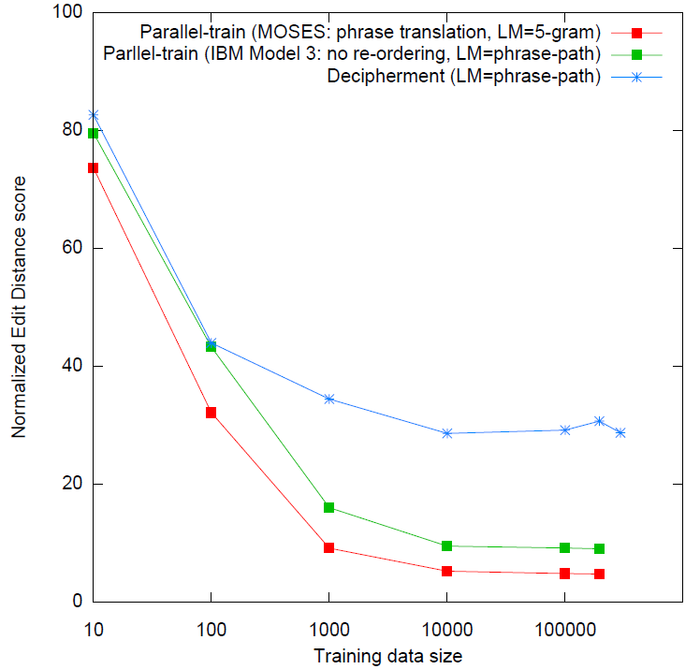
Deciphering Spanish Time Expressions
MT quality
on test set
(Edit distance,
lower is better)
no parallel data,
word-based MT
parallel data,
word-based MT
parallel data,
phrase-based MT
[Ravi & Knight 11]
local re-ordering

Slide 117
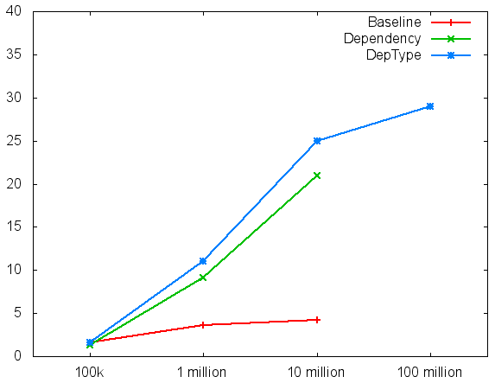
Deciphering Foreign Language at Giga-Scale
Accuracy of learned
bilingual dictionary
(Dou & Knight subm.)
not translations
of each other
Spanish/English
English
text
Foreign
text
New decipherment
algorithm
deciphering
engine
bilingual
word-for-word
dictionary
(Dou & Knight 2012)
How much foreign text (running words)

Slide 118
Practical Value
Scenarios where in-domain parallel data is scarce.
Decipher large monolingual in-domain corpora to improve systems trained on small amounts of parallel text

Slide 119
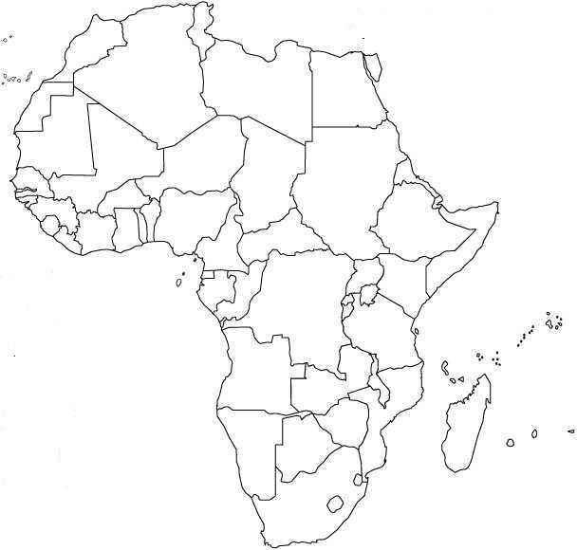
African Languages

Slide 120
African Languages
CONTINENTAL UNITED STATES

Slide 121
African Languages
CONTINENTAL UNITED STATES
ALASKA

Slide 122
African Languages
CONTINENTAL UNITED STATES
ALASKA
GREENLAND

Slide 123
African Languages
CONTINENTAL UNITED STATES
INDIA
AND
PAKISTAN
ALASKA
GREENLAND

Slide 124
African Languages
CONTINENTAL UNITED STATES
INDIA
AND
PAKISTAN
ALASKA
GREENLAND
SOUTHEAST
ASIA

Slide 125
African Languages
CONTINENTAL UNITED STATES
INDIA
AND
PAKISTAN
ALASKA
GREENLAND
SOUTHEAST
ASIA
MEXICO

Slide 126
African Languages
CONTINENTAL UNITED STATES
INDIA
AND
PAKISTAN
ALASKA
GREENLAND
SOUTHEAST
ASIA
JAPAN
CENT.
AMERICA
MEXICO

Slide 127
African Languages
CONTINENTAL UNITED STATES
INDIA
AND
PAKISTAN
ALASKA
GREENLAND
SOUTHEAST
ASIA
JAPAN
UKRAINE
CENT.
AMERICA
MEXICO

Slide 128
African Languages
CONTINENTAL UNITED STATES
INDIA
AND
PAKISTAN
ALASKA
GREENLAND
SOUTHEAST
ASIA
EUROPEAN
UNION
JAPAN
UKRAINE
CENT.
AMERICA
MEXICO

Slide 129
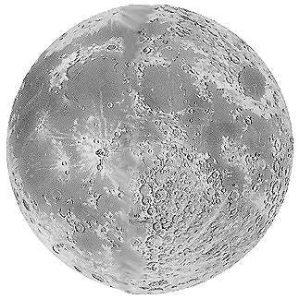
Africa
almost
as big as
the Moon
CONTINENTAL UNITED STATES
INDIA
AND
PAKISTAN
ALASKA
GREENLAND
SOUTHEAST
ASIA
EUROPEAN
UNION
JAPAN
UKRAINE
CENT.
AMERICA
MEXICO

Slide 130
Africa
almost
as big as
the Moon
CONTINENTAL UNITED STATES
INDIA
AND
PAKISTAN
ALASKA
GREENLAND
SOUTHEAST
ASIA
Zero languages
spoken
EUROPEAN
UNION
JAPAN
UKRAINE
CENT.
AMERICA
MEXICO

Slide 131
Africa
almost
as big as
the Moon
CONTINENTAL UNITED STATES
INDIA
AND
PAKISTAN
ALASKA
GREENLAND
SOUTHEAST
ASIA
Zero languages
spoken
EUROPEAN
UNION
1000+ languages
spoken,
40+ by 1m+
speakers
JAPAN
UKRAINE
CENT.
AMERICA
MEXICO

Slide 132
Unsolved ciphers

Slide 133

Voynich Manuscript (VMS)
Medieval illustrated manuscript (early 1400s)
235 pages, 6 sections, 38k word tokens, 35 letter types
Undeciphered

Slide 134
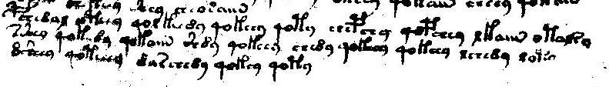
Voynich Manuscript (VMS)
BSC8AE OPCC9 4OE FCC89 4OFCC9 4OP9 SCBS9 4OBSC9 EFAM OPAE29
2ZC9 4OFC89 4OFAM Z89 4OFCC9 SC89 4OFCC9 4OFCC9 ESC89 EOP9
8ZC9 4OPCCC9 8ARSC89 4OFC9 4OP9
BSC8AE OPCC9 4OE FCC89 4OFCC9 4OP9 SCBS9 4OBSC9 EFAM OPAE29
2ZC9 4OFC89 4OFAM Z89 4OFCC9 SC89 4OFCC9 4OFCC9 ESC89 EOP9
8ZC9 4OPCCC9 8ARSC89 4OFC9 4OP9

Slide 135
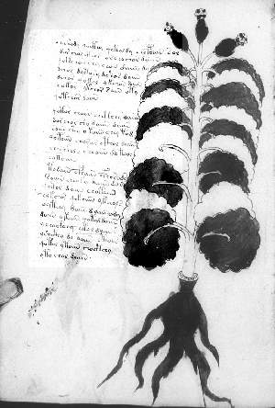
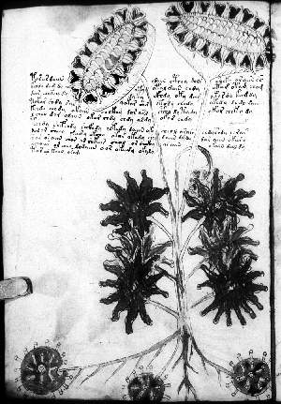
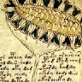
“Herbal” section
Many pictures
look like grafting.
Sunflower? Would date
VMS as post-1492.

Slide 136
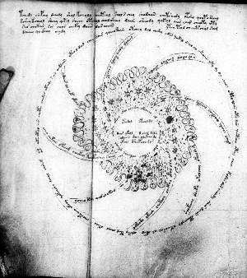
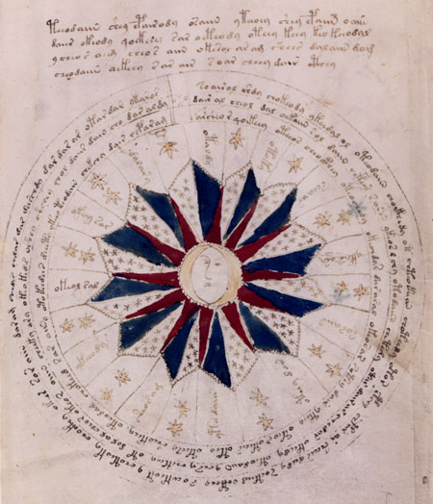
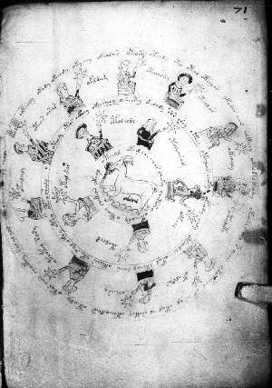
“Astrological” section

Slide 137
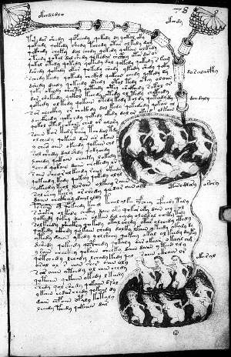
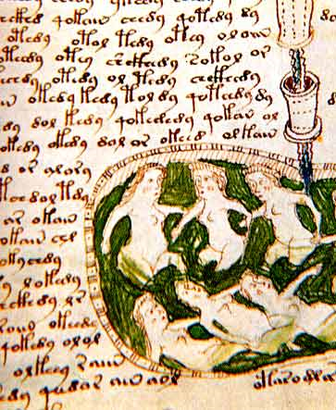
“Biological” section
Small nudes in baths
Interconnecting tubes of liquids

Slide 138
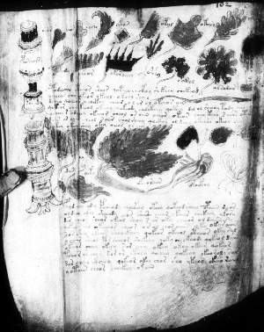
“Pharmacological” section

Slide 139
History of Voynich Manuscript (VMS)
1864 Ethel Boole born in England
1865 WV born in Lithuania
1885 WV imprisoned, Polish nationalist
1890 WV & EB meet, marry in 1902
1898 WV publishes first book list
1912 WV acquires VMS in “ancient castle”
1914 WV moves to USA, opens bookshop
1919 WV sends photostatic copies of VMS
1919 Copying reveals de Tepenecz signature
1919 WV writes to Bohemian State Archvs
1921 WV presents VMS + inserted Marci letter
mentioning Francis Bacon, asks $160k
1921 Newbold & WV announce decipherment
1930 WV dies. VMS placed in vault, $100k
1931 VMS appraised at $19,400
1960 Ethel dies, VMS to secretary Ann Nill
“Castle” revealed as Villa Mondragone
1961 NY dealer Hans Kraus buys for $24,500
1969 Kraus donates VMS to Yale
1972 Brumbaugh finds WV letters in BSA
200x Zandbergen finds 1639 Baresch letter
in newly online Kircher archive
1576-1612 Rudolf II purchases VMS
1608-1622 J. de Tepenecz signs VMS
in Bohemian court
1630s George Baresch owns VMS
sends letter to Kircher
1639 GB writes Kircher again
16xx Marci inherits VMS from GB
1665 Marci sends VMS to Kircher
with letter
1665-80 Kircher owns VMS
1680 Kircher dies

Slide 140
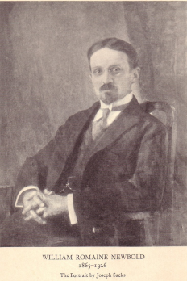
Newbold Decipherment
Marci letter → Bacon → Cabala → “letter doubling” cipher
A B C D E F G H I L M N O P Q R S T U V X Z
A V Z B F G L M N N O …
B C F T U V X …
C F B A Q F C D Z Z …
D
E
F
G
H
I N
L
M A
N
O N
P
Q … …
R
S
T
U … N
V
X
Z
Encoding:
A → CC, OM, …
B → …
…
N → HA, MI, DO, NU …
…
Z → …
Decoding:
…
DO → N
…
22x22 table
Encoder has freedom to devise
a “cover text” to hide real message.
Example:
a n n … → DO MI NU … → DOMINU …

Slide 141
Newbold System
Too hard to assemble good “cover” text!
So, make cipher letter-pairs overlap:
a n n … → AD DB BR … → ADBR …
Then, employ anagramming:
a n n … → OM DO MI … → DO OM MI … → DOMI …
Now can construct a plausible looking “cover” text in Latin for our secret message (also in Latin)
An ingenious system, to be sure!

Slide 142
Newbold Decipherment
Hmm, by the method, both plaintext and ciphertext should be in Latin letters…
But the VMS doesn’t have Latin letters…

Slide 143
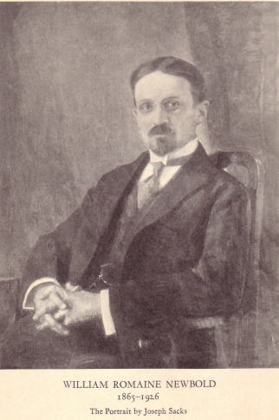
… 4OPCC89 …
apparent
ciphertext
P
William Newbold,
Polymath, PhD UPenn

Slide 144
… 4OPCC89 …
apparent
ciphertext
P
William Newbold,
Polymath, PhD UPenn
real
ciphertext:
DOMI…
I
M
O
D

Slide 145

Let’s Decipher with Newbold !
P
real ciphertext
PCC89 …
DOMI…
I
doubling
apparent ciphertext
M
O
DO OM MI …
D
non-deterministic
anagramming
OM DO MI …
lookup in 22² table
a n n …
non-deterministic
mapping from 11
Latin letters to full 22
o n n …

Slide 146
Let’s Decipher with Newbold !
P
real ciphertext
PCC89 …
DOMI…
I
doubling
apparent ciphertext
M
O
DO OM MI …
D
non-deterministic
anagramming
A B C D E F G H I L M N O P Q R S T U V X Z
A V Z B F G L M N N O …
B C F T U V X …
C F B A Q F C D Z Z …
D
E
F
G
H
I N
L
M A
N
O N
P
Q … …
R
S
T
U … N
V
X
Z
OM DO MI …
lookup in 22² table
a n n …
non-deterministic
mapping from 11
Latin letters to full 22
o n n …
22x22 table
(values guessed)

Slide 147
Newbold’s Results
1300 real ciphertext “letters” in first 3 lines
Decipherment of those first lines:
“I, Roger Bacon, have written this…”
(in Latin)
Anagramming sets of 55 letters is sometimes required.
Slow but steady progress… Andromeda galaxy, ovaries … so … Roger Bacon must have had a microscope & telescope, hundreds of years before they were invented … !

Slide 148
VMS Transcription
BSC8AE OPCC9 4OE FCC89 4OFCC9 4OP9 SCBS9 4OBSC9 EFAM OPAE29
2ZC9 4OFC89 4OFAM Z89 4OFCC9 SC89 4OFCC9 4OFCC9 ESC89 EOP9
8ZC9 4OPCCC9 8ARSC89 4OFC9 4OP9
BSC8AE OPCC9 4OE FCC89 4OFCC9 4OP9 SCBS9 4OBSC9 EFAM OPAE29
2ZC9 4OFC89 4OFAM Z89 4OFCC9 SC89 4OFCC9 4OFCC9 ESC89 EOP9
8ZC9 4OPCCC9 8ARSC89 4OFC9 4OP9
last paragraph, f103r

Slide 149
Alphabet: Currier/D’Imperio Transcription
C S Z
C S Z
P F B V
P F B V
Q X W Y
Q X W Y
J A E R O I D
J A E R O I D
6 7 8 9 4 2
6 7 8 9 4 2
G H 1
G H 1
T U 0
T U 0
N M 3
N M 3
K L 5
K L 5

Slide 150
VMS Letters
count letter
count letter
count letter
O C 9 A 8 S E F R P 4 Z M
2886 2
1752 N
1413 B
1046 J
950 Q
908 X
591 T
524 *
431 V
316 I
217 W
157 D
156 3
2 N B J Q X T * V I W D 3
U 6 Y K G L H 1 5 0
25468 O
20227 C
17655 9
14281 A
12973 8
11008 S
10471 E
10026 F
6716 R
5994 P
5423 4
4501 Z
4076 M
148 U
96 6
74 Y
52 K
31 G
17 L
14 H
2 1
1 5
1 0
Total
63k character tokens

Slide 151
VMS Words
count word
count word
count word
863 8AM
537 OE
501 SC89
469 AM
426 ZC89
396 SOE
363 OR
350 AR
344 SC9
318 8AR
308 4OFCC9
305 4OFCC89
283 ZC9
279 4OFAN
272 4OFC89
270 89
262 4OFAM
260 AE
253 8AE
243 2
219 SOR
8AM OE SC89 AM ZC89 SOE OR AR SC9 8AR 4OFCC9 4OFCC89 ZC9 4OFAN 4OFC89 89 4OFAM AE 8AE 2 SOR
212 OFAM
211 8AN
191 4OFAE
186 ZOE
177 OFCC9
174 SCC9
172 SCOE
155 S9
155 OPC89
154 OPAM
152 4OFAR
151 9
151 4OE
150 S89
147 4OF9
144 ZCC9
144 OFAN
144 2AM
143 OPAE
141 OPAR
140 SX9
OFAM 8AN 4OFAE ZOE OFCC9 SCC9 SCOE S9 OPC89 OPAM 4OFAR 9 4OE S89 4OF9 ZCC9 OFAN 2AM OPAE OPAR SX9
140 OPCC9
138 OFAE
130 ZO
129 OFAR
119 ESC89
118 OFC89
OPCC9 OFAE ZO OFAR ESC89 OFC89
+ many more!
Total:
8116 distinct words

Slide 152
VMS Word Bigrams
Very few repeated bigrams: Extremely troubling!
Nothing like “of the” in English.
115 (out of 8116) distinct words appear doubled
… 4OFCC89 4OFCC89 …
8 distinct words appear tripled
… 4OFC89 4OFC89 4OFC89 …
… SOE SOE SOE …
… ZCOE ZCOE ZCOE …
… OFAM OFAM OFAM …
… OE OE OE …
… 9PAM 9PAM 9PAM …
… 8AM 8AM 8AM …
… 4OFCC89 4OFCC89 4OFCC89 …

Slide 153

Substitution Cipher?
Nope.
Tried 80+ languages.
For example, if we decipher assuming Latin plaintext:
Tried 80+ languages written without vowels.
quiss squm is onum pom
quss hates s qum hatis …
???

Slide 154


Letter Clustering
Trigram model over {a, b, _ }
a a _ b a b _ a b a a _ …
Sample tagging with learned model:
a b _ b b a _ b a b b _
i n _ t h e _ t o w n _
b b a b a _ a _ …
w h e r e _ i _ …
a →
b →
_ → _
i n _ t h e _ t o w n _ w h e r e _ i _ was …

Slide 155
Letter Clustering
Trigram model over {a, b, _ }
a a _ b a b _ a b a a _ …
Sample tagging with learned model:
? ? ? ? ? _ ? ? ? ? _ ? ? _
V A S 9 2 _ 9 F A E _ A R _
? ? ? ? _ ? ? ? _ ? ? ? ? _ …
A P A M _ Z O E _ Z O R 9 _ …
?
a → {all Voynich letters}
b → {all Voynich letters}
_ → _
?
V A S 9 2 _ 9 F A E _ A R _ A P A M _ …

Slide 156


Letter Clustering
Trigram model over {a, b, _ }
a a _ b a b _ a b a a _ …
Sample tagging with learned model:
b b b b a _ a b b a _ b a _
V A S 9 2 _ 9 F A E _ A R _
b b b a _ b b a _ b b b a _ …
A P A M _ Z O E _ Z O R 9 _ …
a →
b →
_ → _
V A S 9 2 _ 9 F A E _ A R _ A P A M _ …

Slide 157



Letter Clustering
P(letter | tag)
P(tag | letter)
a →
b →
P(a)
English
P(a)
a →
b →
Voynich

Slide 158


Word Clustering
Bigram model over {a, b}
Sample tagging with learned model:
a a a a a
VAS92 9FAE AR APAM ZOE
a a a a a …
ZOR9 QRC2 9 FOR ZOE89 …
a a b a b a b a a …
a →
b →
WAIT,
WHAT?
VAS92 9FAE AR APAM ZOE ZOR9 QRC2 9 ...

Slide 159
Word Clustering
Voynich words tagged as "a"
← pages →
Voynich words tagged as "b"
Herbal
Astro
Bio
Pharma
Stars
Voynich sections, per drawings observed.
Captain Currier’s "two languages" (1976).

Slide 160


1970s National Security Agency
report recently declassified!

Slide 161

National Security Agency
Association for Computational Linguistics
NSA applies statistics to
ciphers, codes, and other
language processing problems
NSA employs more
mathematicians and
linguists than any other
organization.
NSA has more computers
than any other organization.
1950s
1960s
1970s paper on
HMM Voynich
1970s
1980s
1993 paper
on Statistical
Machine
Translation
1990s
Oh yeah -- we’ve been
on Mars since 1962.
ACL applies statistics
to language processing
problems
2000s
2010s
2011 paper on
HMM Voynich
2020s
Slacker (1991)
dir. Richard Linklater

Slide 162

CRYPTOLOG
NSA newsletter declassified
in 2013.
4400 pages (1974-1997).
238 Mbyte PDF file.
Covers intelligence gathering,
linguistics, military, cryptography,
office space, pay grades, human
factors, etc.
Heavily redacted.

Slide 163



CRYPTOLOG: Voynich

Slide 164



CRYPTOLOG: Machine Translation

Slide 165

CRYPTOLOG: Evaluating Translations

Slide 166




CRYPTOLOG: Linguists

Slide 167
Back to Word Clustering
Bigram model over {a, b}
Let’s try 10 clusters.
Let’s limit ourselves to the
more homogenous Bio + Stars
sections.
a a b a b a b a a …
a →
b →
VAS92 9FAE AR APAM ZOE ZOR9 QRC2 9 ...

Slide 168




10-Class Word Clustering: English
etc
etc
etc
etc
etc
etc

Slide 169









a
b
d
10 Classes:
Voynich-B
c
f
e
g
h
i
j

Slide 170
10 clusters: Voynich-B
Tags per
page.
“Bio” words vs.
“Stars” words

Slide 171
Does VMS Have Content Words?
Measure the saliency of a word in a page with TF-IDF
# times that word w occurs in page d
# pages that contain word w
(Reddy & Knight, 2011)

Slide 172
Does VMS Have Content Words?

Slide 173
Do Content Words Indicate Topics?

Slide 174
Are VMS Pages in Order?
Measure similarity between a pair of pages using cosine similarity (with bag-of-words)
Count the % of pages P where the most similar page to P is adjacent to it

Slide 175


Is VMS Prose?
Special ligatures at beginning of “paragraphs”
Looks like paragraph structure
BUT:
Lines begin and end disproportionately often with certain characters!
The line is a functional entity…

Slide 176
Are VMS Word Sequences Predictable?
Guess most likely word to follow current word
Simulate game from bigram probabilities 90-10 train-test splits
Voynich does not have
many repeated bigrams.

Slide 177

Zodiac Killer Ciphers
Zodiac 408 (solved, 1969)
Zodiac 340 (still unsolved)

Slide 178


Zodiac Serial Killer
408-letter cipher (solved):
(plus two more sections)

Slide 179

Zodiac Serial Killer
Plaintext solution
Plaintext has many misspellings
Final 18 plaintext characters of 408 are "junk"

Slide 180
Deciphering Zodiac 408 Bayesian models & Gibbs sampling
Language Model | Initial Sample | Decipherment Error
3-gram | Random | 62.3
5-gram | Random | all wrong!
" | 3-gram solution | 42.6
Word 1-gram | Random | all wrong!
Interpolated 5-gram and word 1-gram | Random | 79.2
" | 5-gram solution | 3.3 / 2.6
[Ravi & Knight 11]
See also Malte Nuhn’s
paper at ACL 2013!

Slide 181
Unsolved Zodiac 340
Has no obvious reading order bias:
Could be nonsense … or maybe bigrams are smoothed out via
more careful substitutions.
% cipher bigram types that repeat (freq > 1) | Left/ Right order | Up/ Down order | Diag. North-East | Diag. South- East
Zodiac 408 (solved) | 13 % | 5 | 7 | 5
Zodiac 340 (unsolved) | 7 | 6 | 8 | 5

Slide 182





Other Unsolved Ciphers
Beale (1885)
Dorabella (1897)
Kryptos (1990)
OBKR
UOXOGHULBSOLIFBBWFLRVQQPRNGKSSO
TWTQSJQSSEKZZWATJKLUDIAWINFBNYP
VTTMZFPKWGDKZXTJCDIGKUHUAUEKCAR
NYPVTT = BERLIN (2011 clue)
Taman Shud
(1948)
FBI (1999)
(2 pp total)

Slide 183




Collected Ciphers
+ many more!

Slide 184
Writing as a code for speech

Slide 185

Archaeological Decipherment
ciphertext
Mayan
glyphs

Slide 186


Archaeological Decipherment
Thinks Mayan decipherment should be based on
ideographic rather than linguistic principles.
ciphertext
Resists notion that the glyphs
have a phonetic component.
It’s phonetic.
Mayan
glyphs
J. Eric S. Thompson
Yuri Knorozov

Slide 187
Archaeological Decipherment
Mayan glyphs
Egyptian glyphs (Rosetta Stone)
Linear B
etc
Computer did not play much of a role in these successful decipherments

Slide 188

Archaeological Decipherment
ciphertext
[Knight & Yamada 99]

Slide 189
Archaeological Decipherment
ciphertext
primera parte
del ingenioso
hidalgo don …
[Knight & Yamada 99]

Slide 190
Archaeological Decipherment
"When I look at these squiggles, I say to myself, this is really a sequence of Spanish phonemes, but it has been encoded in some strange symbols…"
ciphertext
primera parte
del ingenioso
hidalgo don …
(Don Quixote)
OUR HERO
[Knight & Yamada 99]

Slide 191
Archaeological Decipherment
ciphertext
primera parte
del ingenioso
hidalgo don …
(Don Quixote)
Modern
Spanish
sounds
?
Phoneme
trigram model
P(L | tS a) = 0.03
Phoneme-to-
letter model
P(y | L) = ?
26 sounds:
B, D, G, J (canyon),
L (yarn), T (thin), a,
b, d, e, f, g, i, k, l,
m, n, o, p , r,
rr (trilled), s,
t, tS, u, x (hat)
32 letters:
ñ, á, é, í, ó, ú,
a, b, c, d, e, f, g,
h, i, j, k, l, m, n,
o, p, q, r, s, t, u
v, w, x, y, z
?
EM approach = 93% accurate phonetic decipherment
[Knight & Yamada 99]

Slide 192
What if Spoken Language Behind Script is Unknown?
Build a universal model P(p) of human phoneme sequence production
human might generally say: K AH N AH R IY
human won’t generally say: R T R K L K
Find a P(c | p) table
such that there is a decoding with a good universal P(p) score
Phoneme & syllable inventory
if z, then s
all have CV syllables; if VCC, then also VC
Syllable sonority structure
dram, lomp, ? rdam, ? lopm
Physiological preference constraints
tomp, tont, ? tomk, ? tonp
[Knight et al 06]

Slide 193
Unknown Source Language
# of
syllables
in word
syllable
type
sequence
consonant/
vowel
sequences
primera parte
del ingenioso
hidalgo don …
P(1) = ?
P(2) = ?
etc.
P(CV) = ?
P(V) = ?
P(CVC) = ?
+ 7 others
P(V | V) = ?
P(VV | V) = ?
P(a | V) = ?
P(a | C) = ?
etc.
Input: primera parte del ingenioso …
Output: NSV.NV.NV NVS.NV NVS VS.NV.SV.V.NV …
S = sonorous consonant phoneme
N = non-sonorous consonant phoneme
V = vowel phoneme
[Knight et al 06]
See Y. Kim & B. Snyder’s
ACL 2013 paper addressing
100s of human languages!

Slide 194

Practical Detour: Phoneme Substitution Ciphers
When I look at street signs in Tokyo, I say: this is really written in English, but it has been coded in some strange symbols. I will now proceed to decode!
Parallel data: [Knight & Graehl 97]
Non-parallel data: [Ravi & Knight 09a]
OUR HERO

Slide 195
Undeciphered Writing Systems

Slide 196




Undeciphered writing systems
Indus Valley
Script
(3300BC)
Linear A
(1900BC)
Rongorongo (1800s?)
Phaistos Disc (1700BC?)

Slide 197
Conclusions

Slide 198


Decipherment and NLP
MACHINE TRANSLATION
SPEECH RECOGNITION
[Brown et al 90]
[Bahl, Jelinek, Mercer 83]
FINANCE
[Bahl & Mercer 76]
part-of-speech tagging
[Jelinek, Bahl,
Mercer 75]
Brown &
Mercer
[today]
[Jelinek 69]
STATISTICAL NLP
[Viterbi 67]
COMPUTER
GAMES
[Fano 63]
[Shannon 51]
English n-gram LM
[Kelly 56]
[Shannon 50]
[Shannon 48]
[Shannon 49]
[Shannon 46]
CRYPTOGRAPHY
INFORMATION
THEORY
… insights into communication theory &
cryptography developed simultaneously
and “they were so close together you
couldn’t separate them” (Shannon)
[Hartley 28]

Slide 199




Decipherment and NLP
 | Cryptography | Translation
Manual | Manual encoding | Human translation
Mechanical | Mechanical encoding; intuition-based decryption | Rule-based MT
Mathematical | Computer decryption, based on information theory | Statistical MT
Higher math, deeper understanding | Public-key systems, based on number theory | ??? ??? ???
1920s
1960s
1950s
1990s
1980s
2020s

Slide 200
thanks

